Slide 1
A 21st century lunch bell
Thomas Gölles & Stephan Bisser
Notes:
This slide is mandatory. Please do not remove.

Slide 2

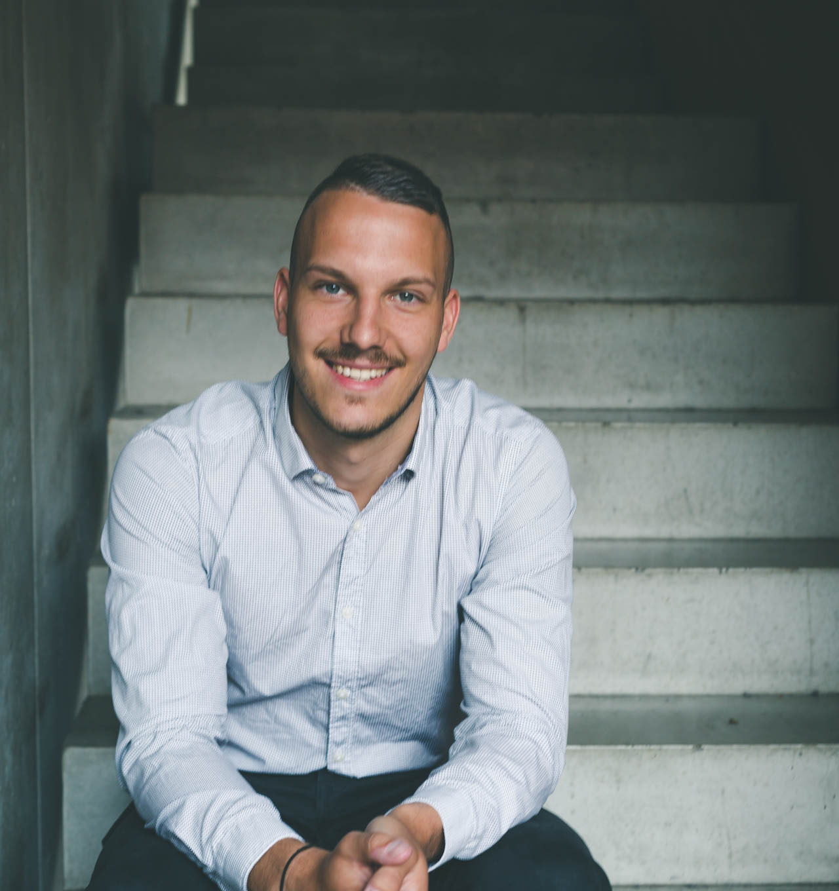




Thomas Gölles
Stephan Bisser
Microsoft MVP (O365)
Microsoft MVP (AI)
SOLVION
SOLVION
http://www.modernworkplacesolutions.rocks
https://www.cloudguy.pro
@thomyg
@cloudguy_pro
Head of Modern Workplace Solutions
#AskCloudguy

Slide 3
Notes:
This slide is mandatory. Please do not remove and try to use it during Q&A at the end of your session. Thank you!

Slide 4
WiFi Keys for Attendees
Connect to the wireless network MSFTGUEST
Click on Event Attendee Code and enter the access code: msevent47pu

Slide 5
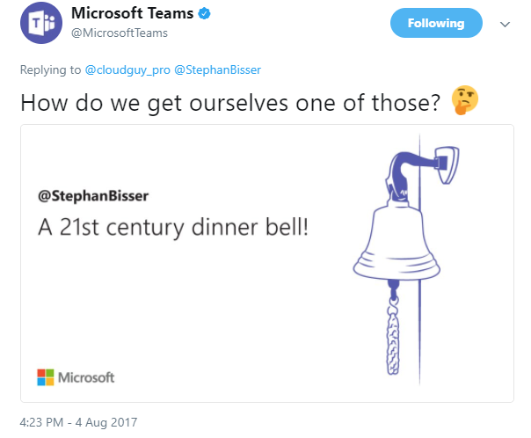
Agenda
1
Background
2
“Bussiness Problem”
3
Tech geek out
4
Demo

Slide 6
Background

Slide 7
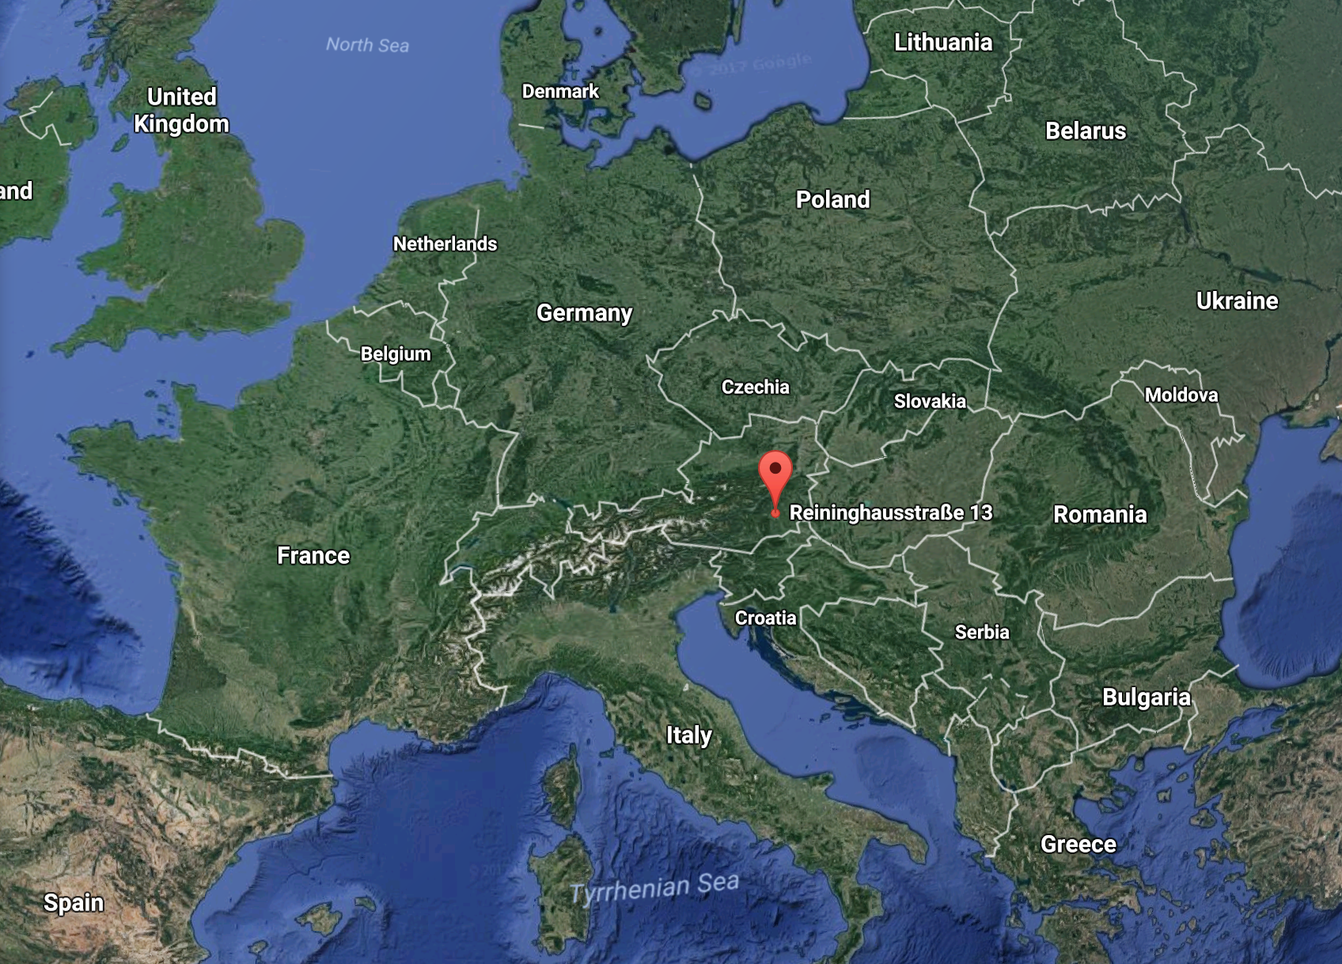
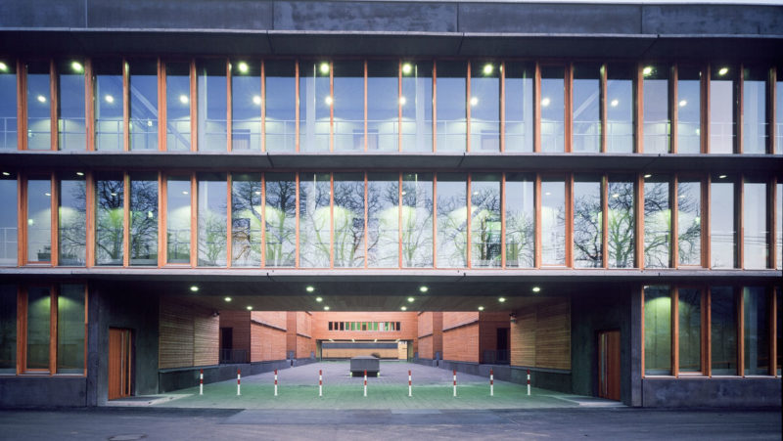
Our Office in Graz, Austria

Slide 8
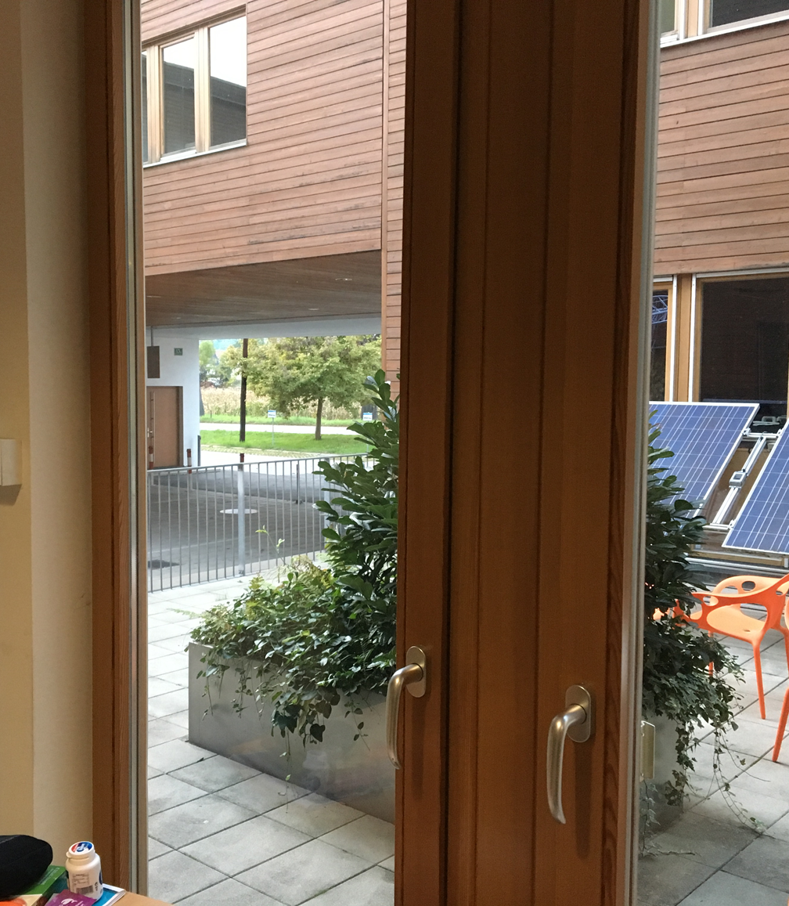
This was Thomy‘s view before he switched rooms

Slide 9
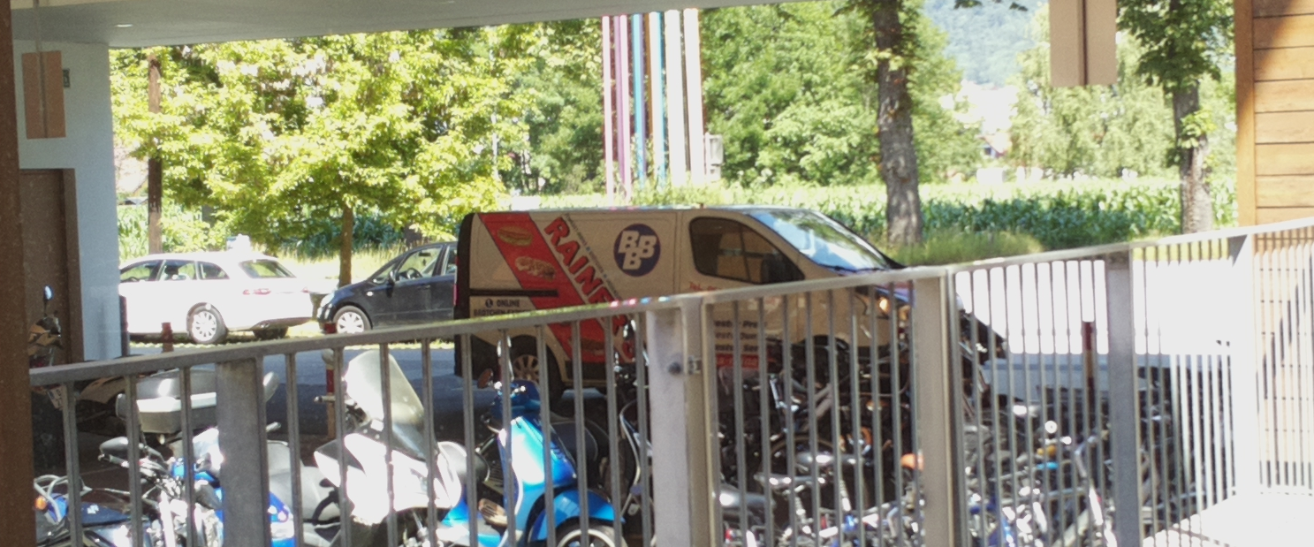
Lunchtime at our office (around 10:45)

Slide 10
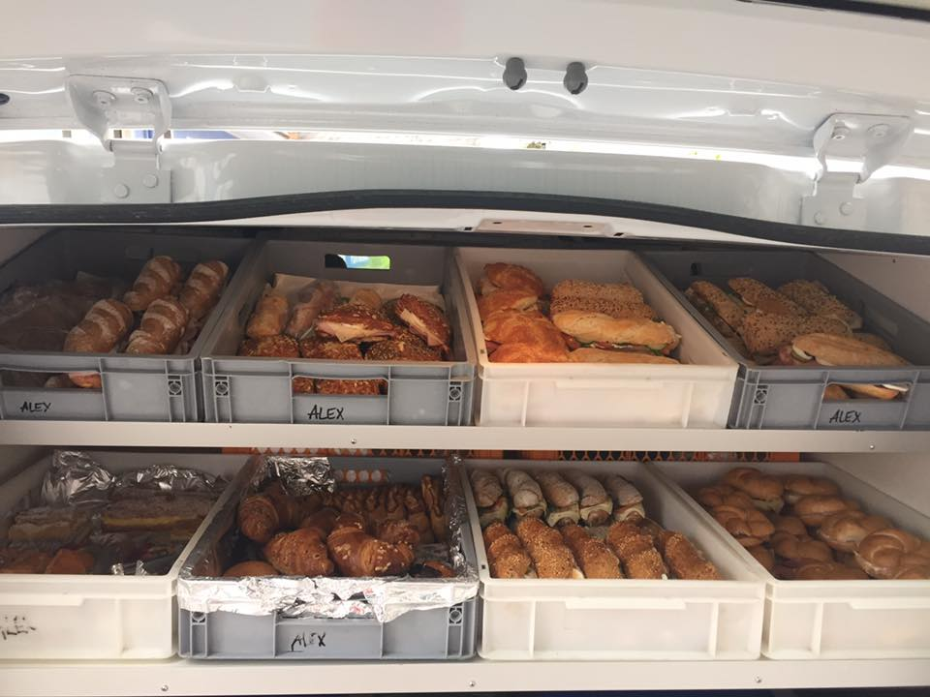
Yummy

Slide 11
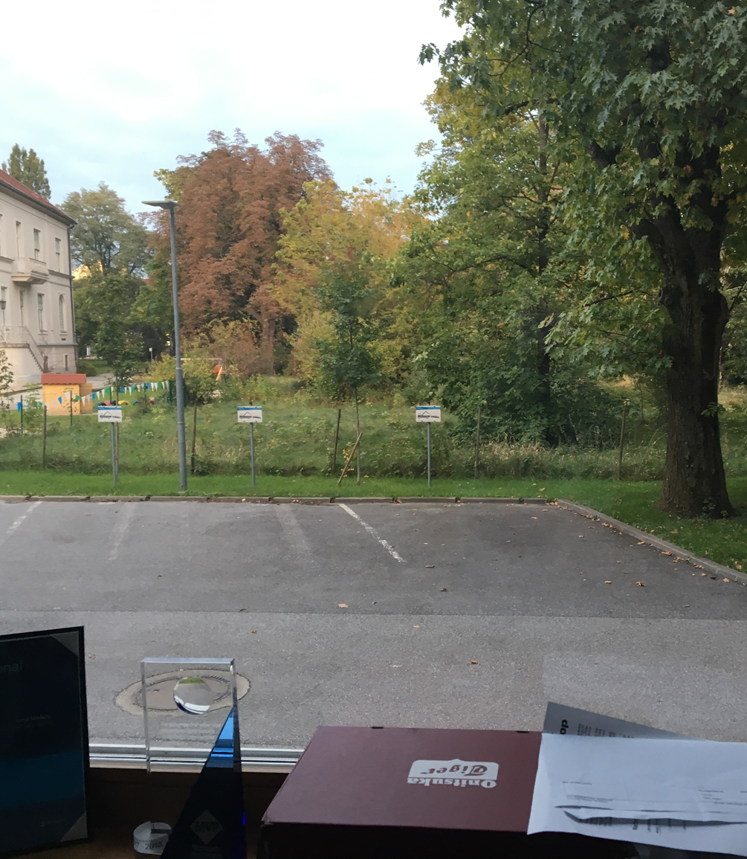
This is Thomy‘s view after he switched rooms (now)

Slide 12
How can Thomy solve that problem?

Slide 13
Possible solutions
Create a recurrent event in Outlook
“Ping” a colleague everyday
Stand up and have a look
Use technology to solve the problem

Slide 14
As a geek you have to do something awesome

Slide 15
MOCADESYMO was born
Penny: Well, you know, it’s the Cheesecake Factory. People order cheesecake, and I bring it to them.
Leonard: So, you sort of act as a Carbohydrate Delivery System.
Penny: Yeah, call it whatever you want, I get minimum wage.
Mobile
Monitor

Slide 16
Who or what is MOCADESYMO?

Slide 17
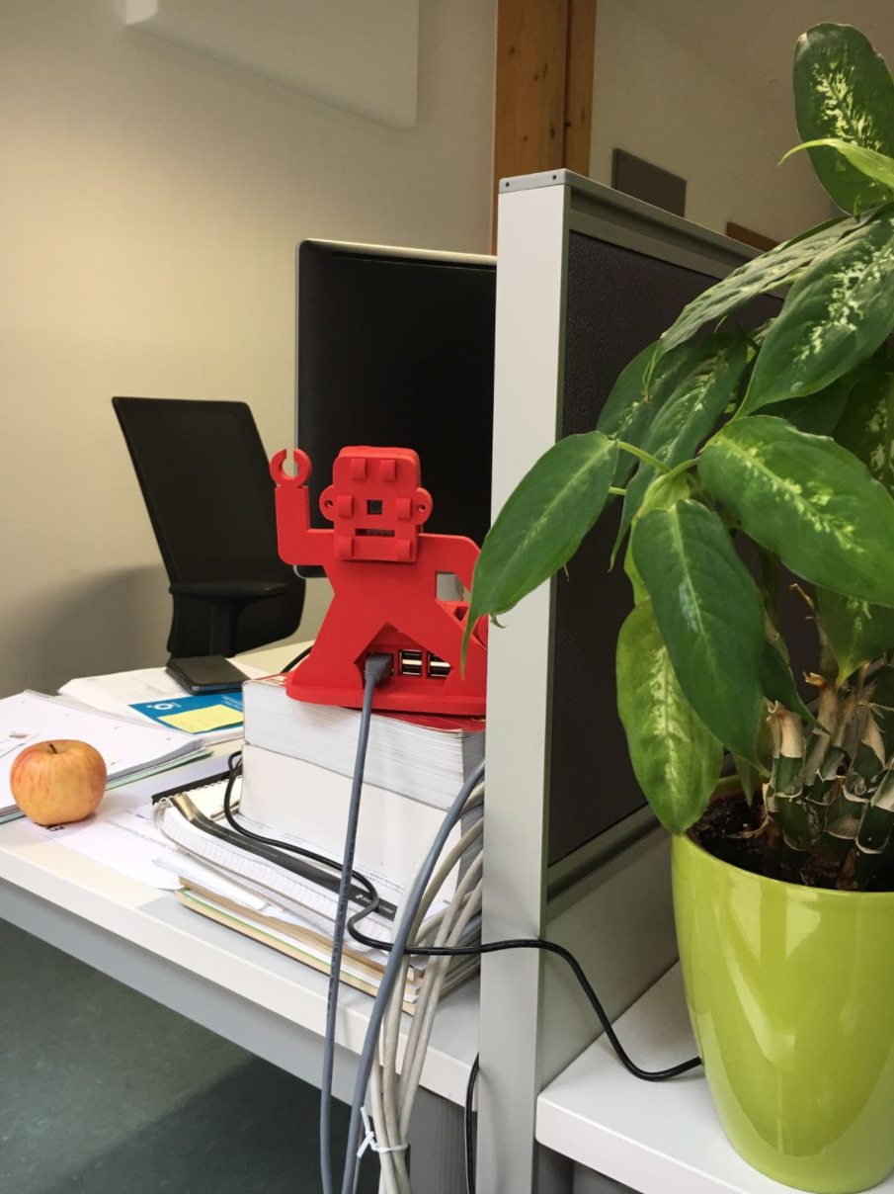
Hi, I‘m MOCADESYMO – your 21st century lunchbell

Slide 18
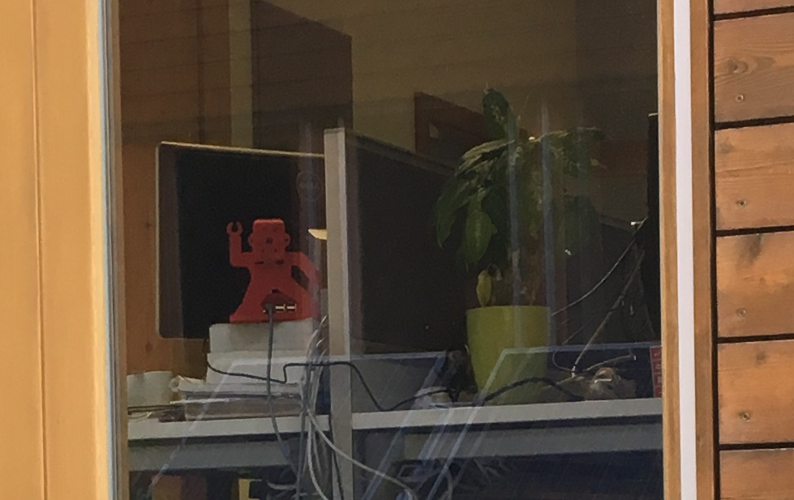
MOCADESYMO‘s view

Slide 19
Architecture of the 21st century lunchbell

Slide 20
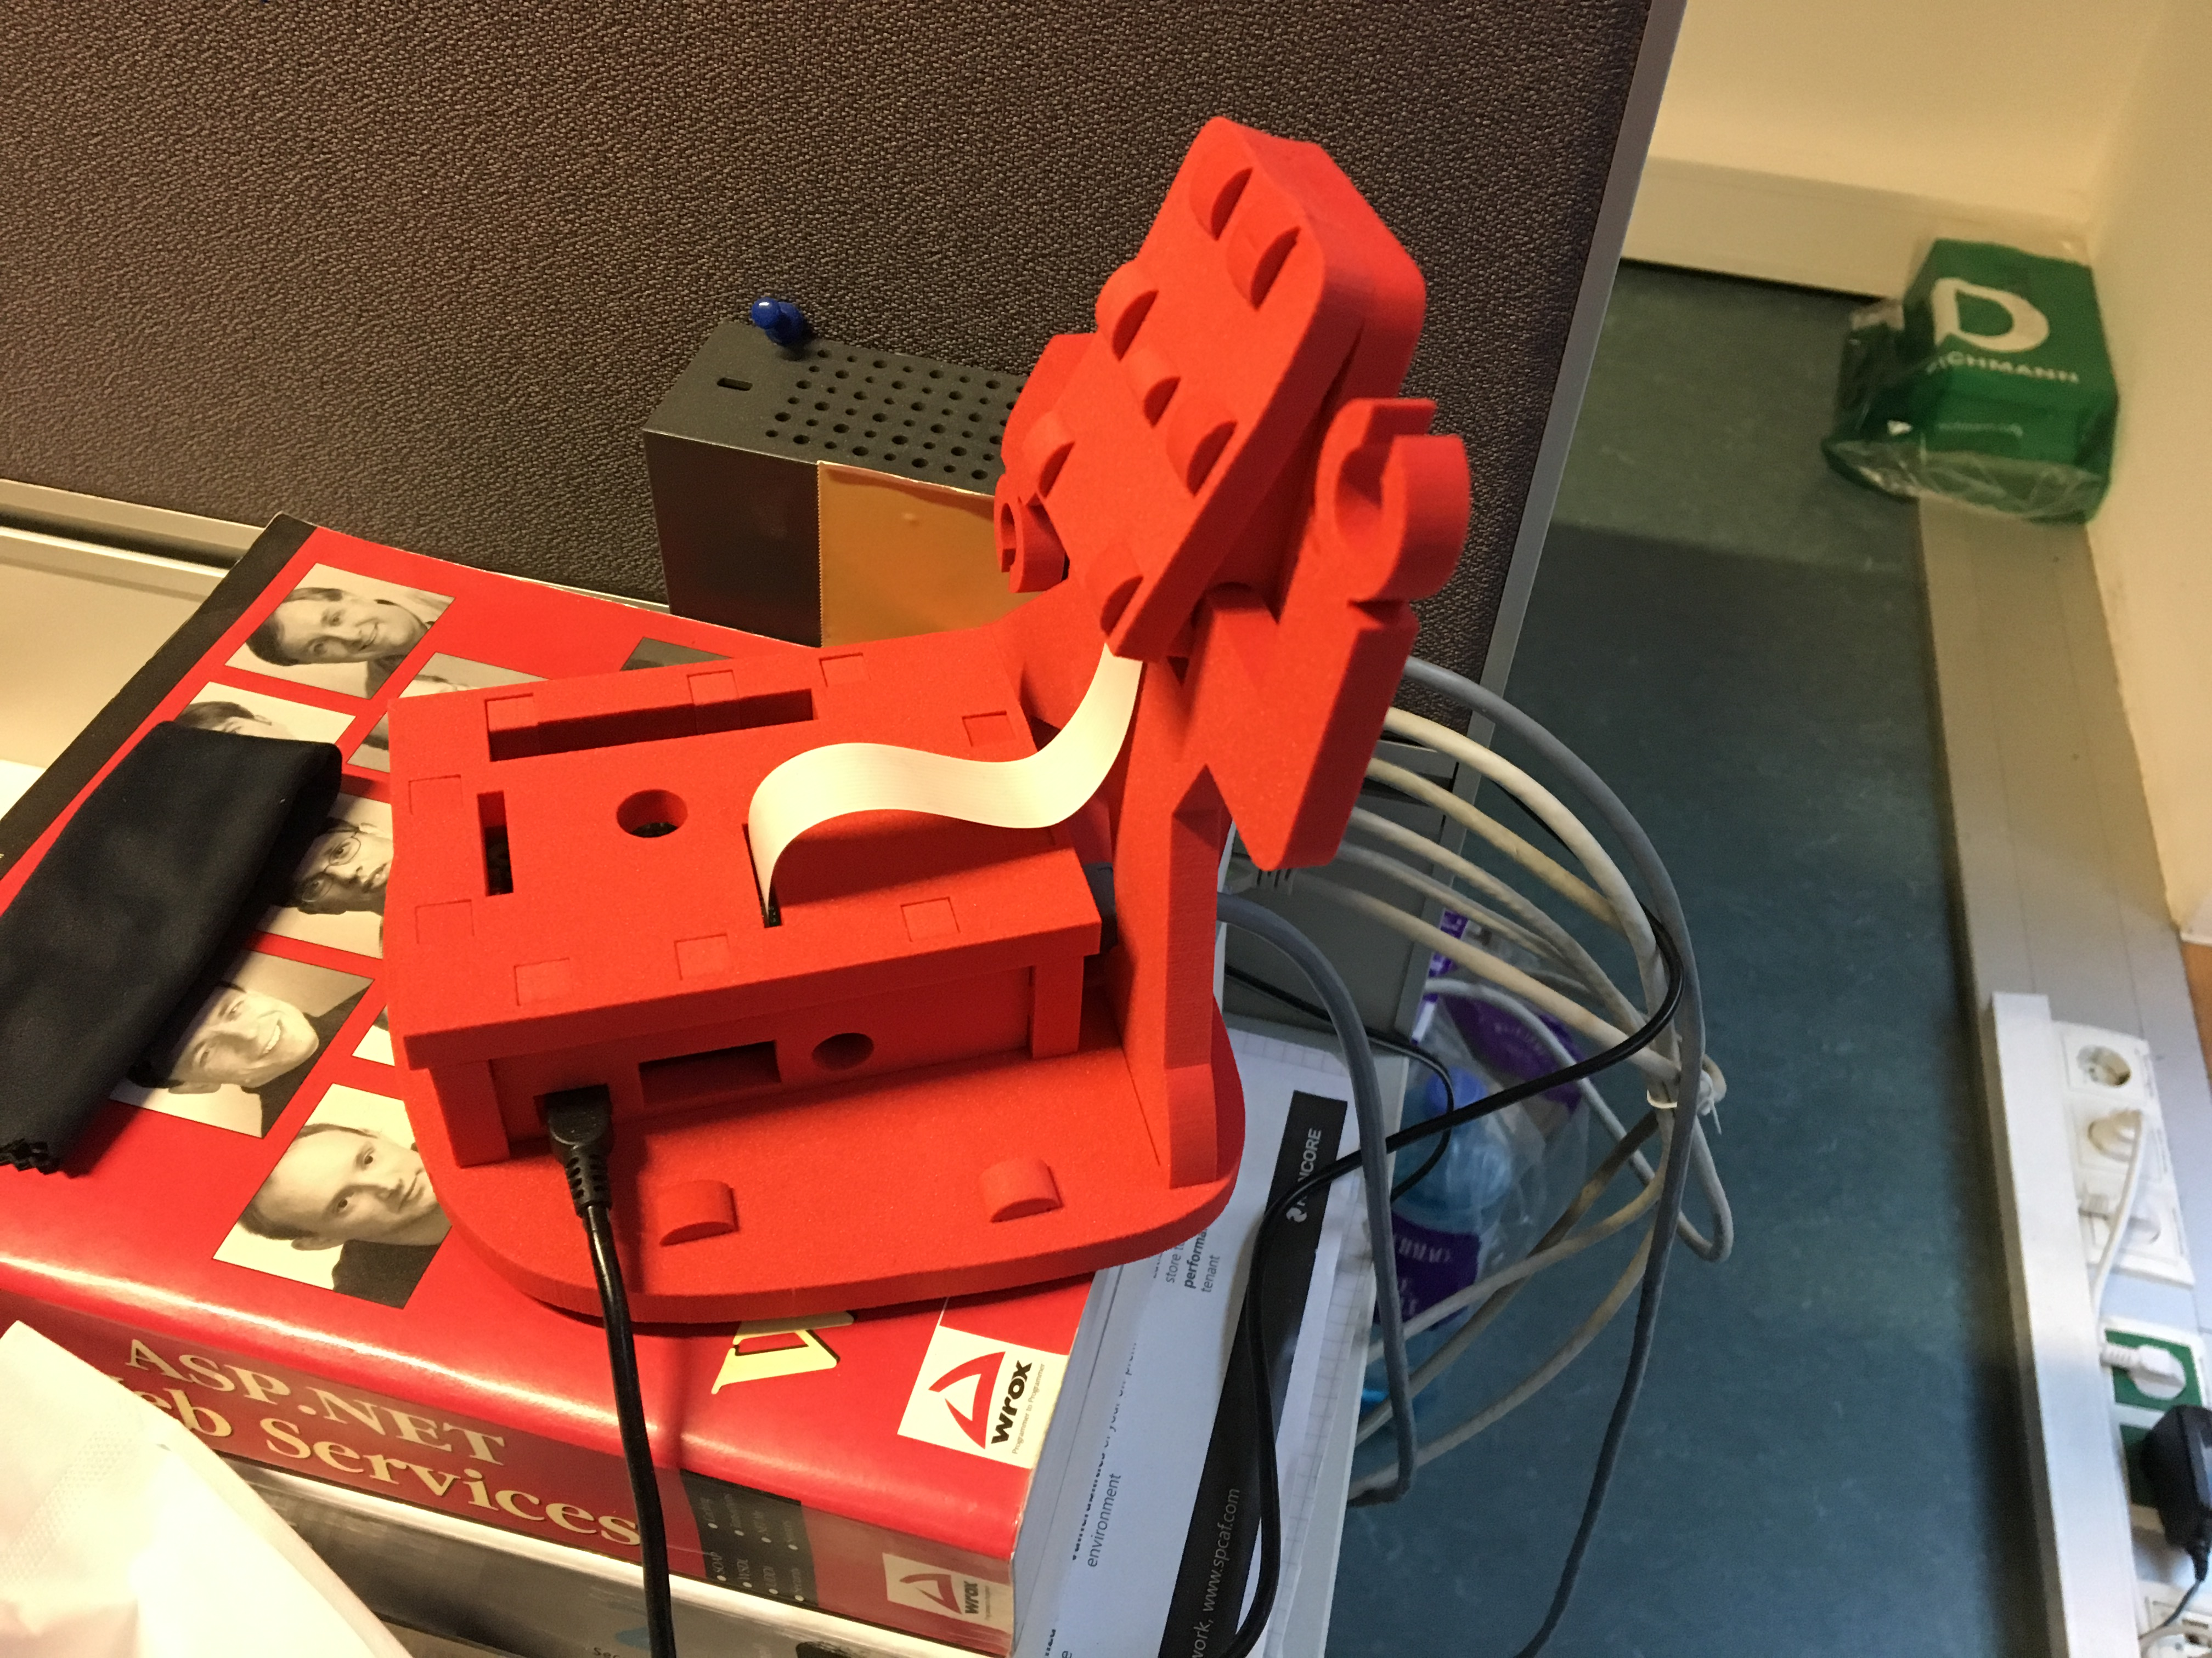
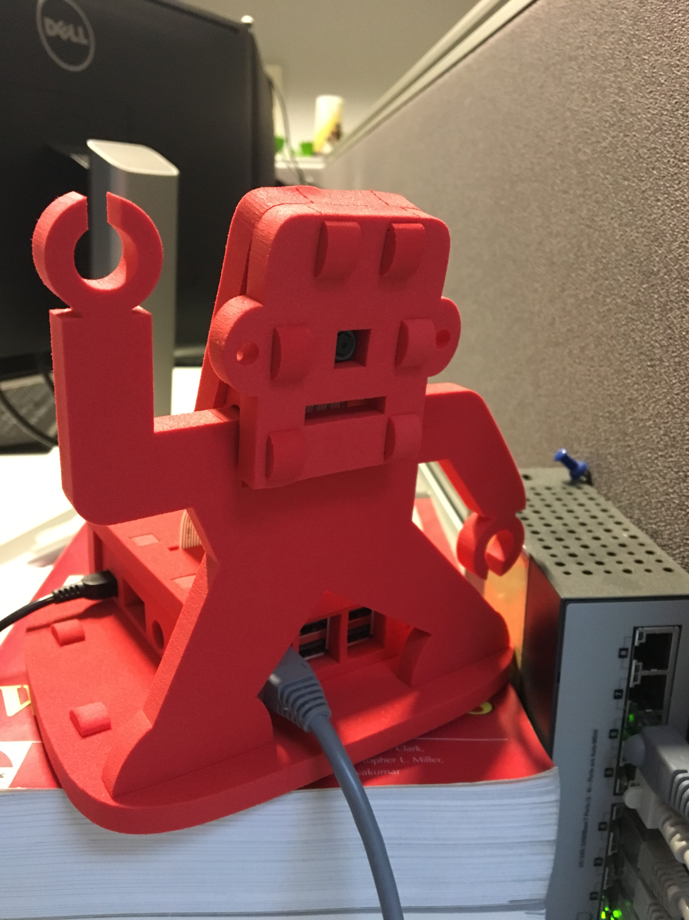
Raspberry Pi + camera module

Slide 21
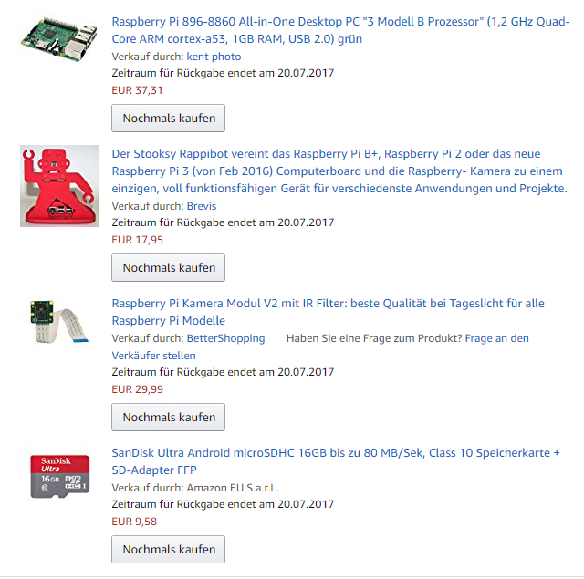
Parts

Slide 22
Pi Setup/Tools
Runs Raspbian Jessie
Lan/Wlan connection
raspistill for taking images
mogrify for cropping the image
Azure CLI 2.0
curl

Slide 23
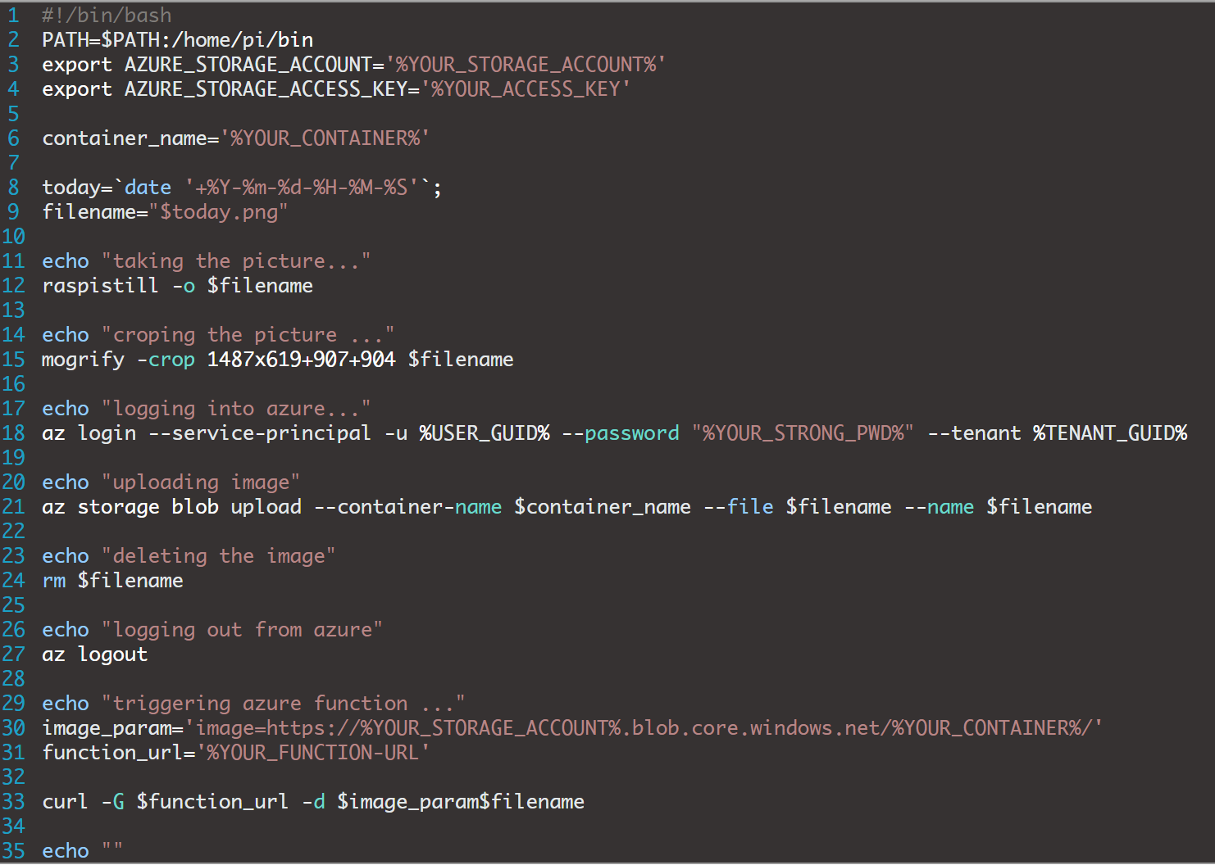
Shell script

Slide 24
Azure components
Blob Storage
Azure Function
Custom Vision API
Storage Tables

Slide 25
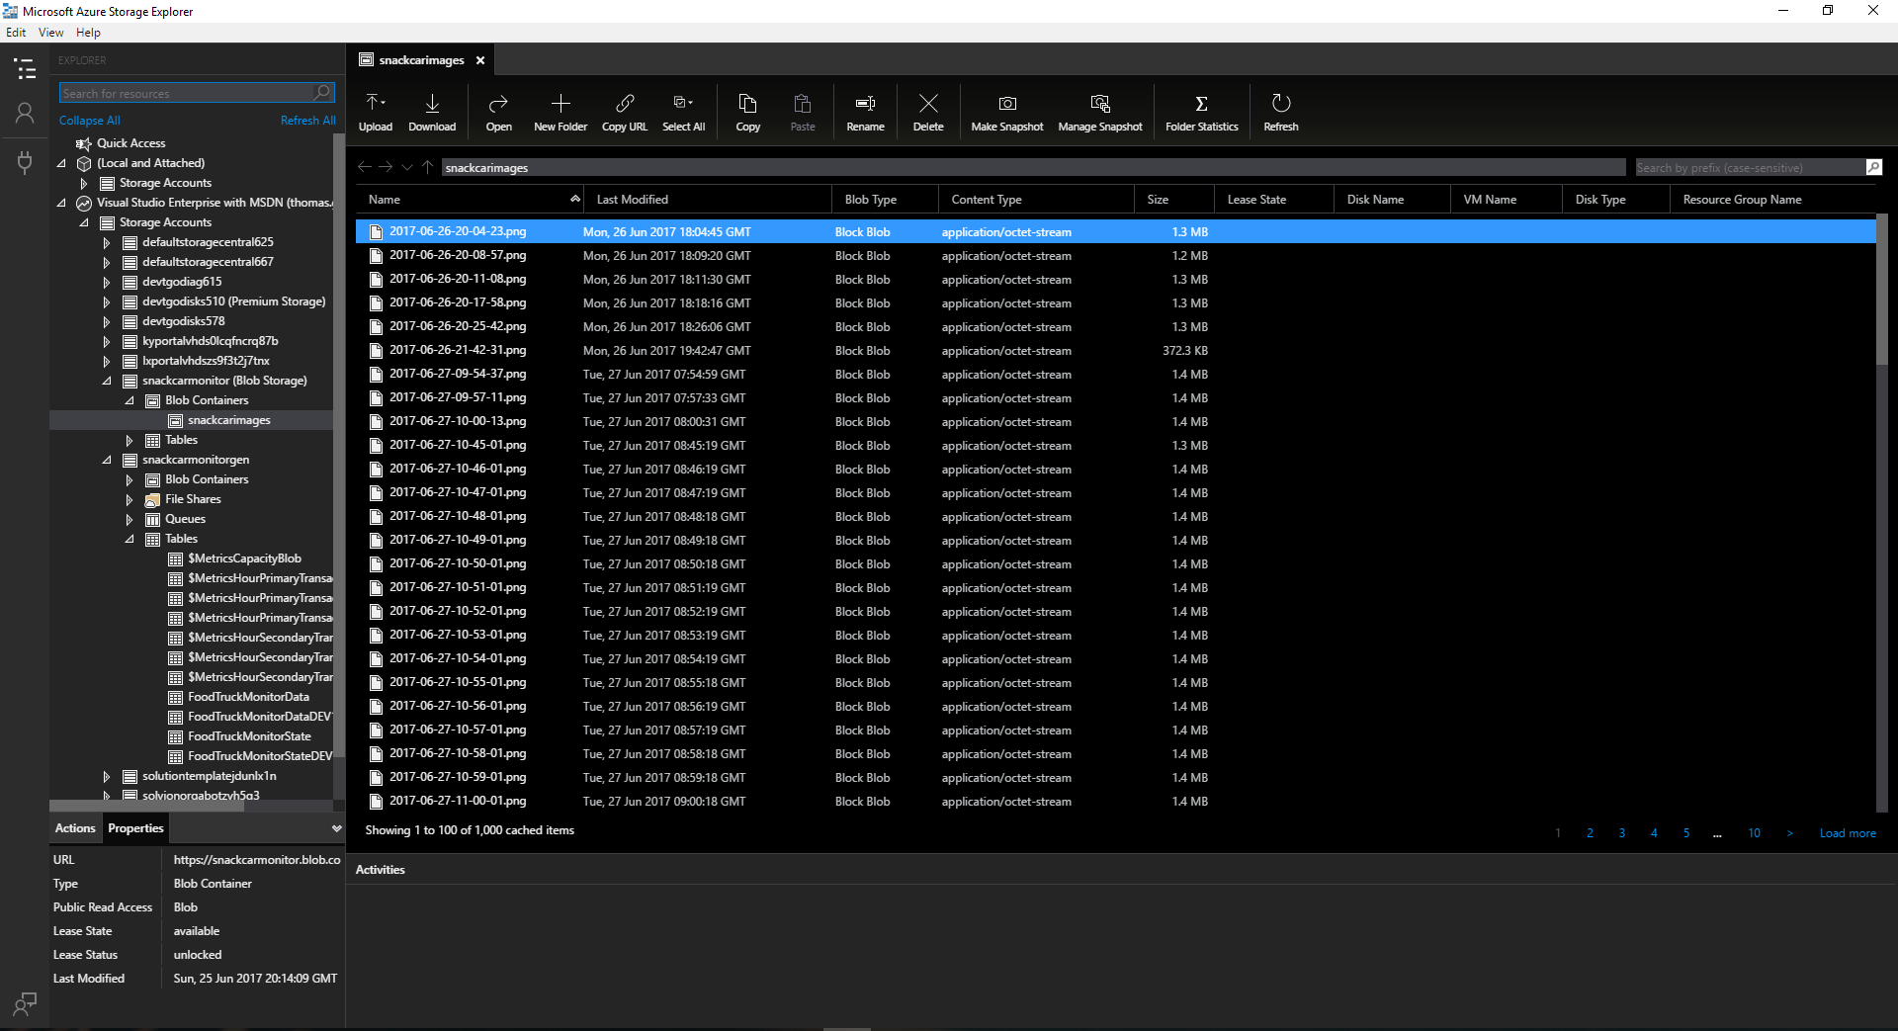
Blob Storage

Slide 26
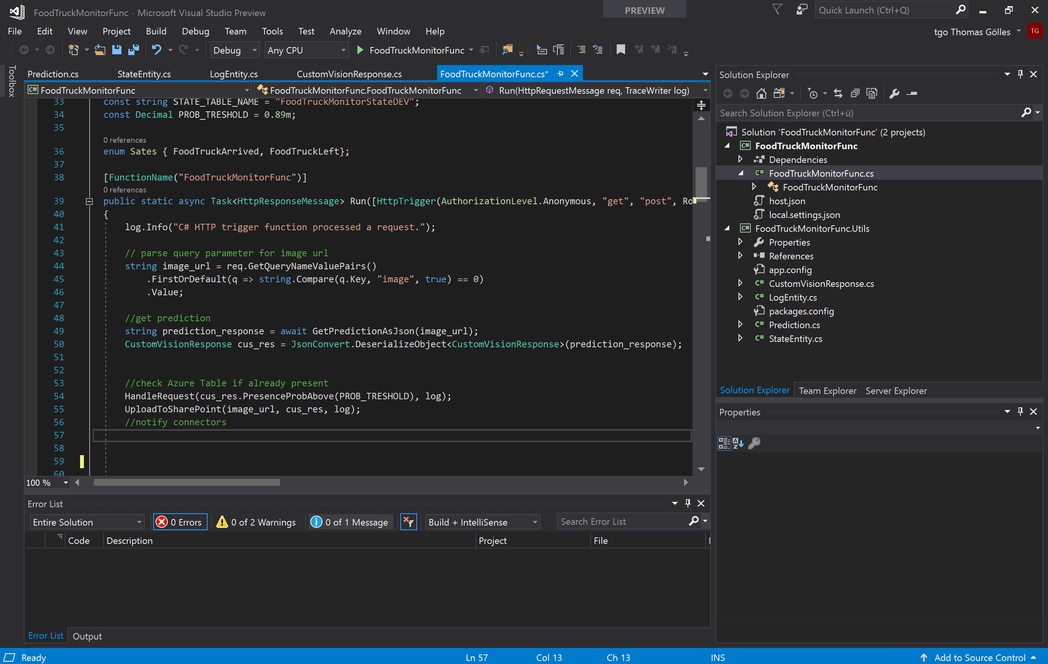
Azure Function
Min. Visual Studio 2017 Update 2
Usage of custom library
Including PnP library
Gets triggered by the curl request from the Pi
Takes the image from the blob storage

Slide 27
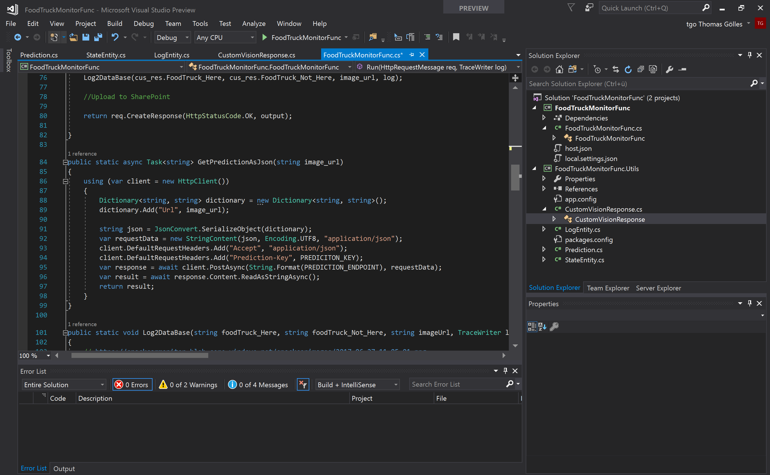
Azure Function
Calls Custom Vision API
Gets back the prediction result from http request
Stores data to log and state tables
Informs users in Teams by calling a connector if prediction is above a certain threshold
uploads pictures to a SharePoint Portal

Slide 28
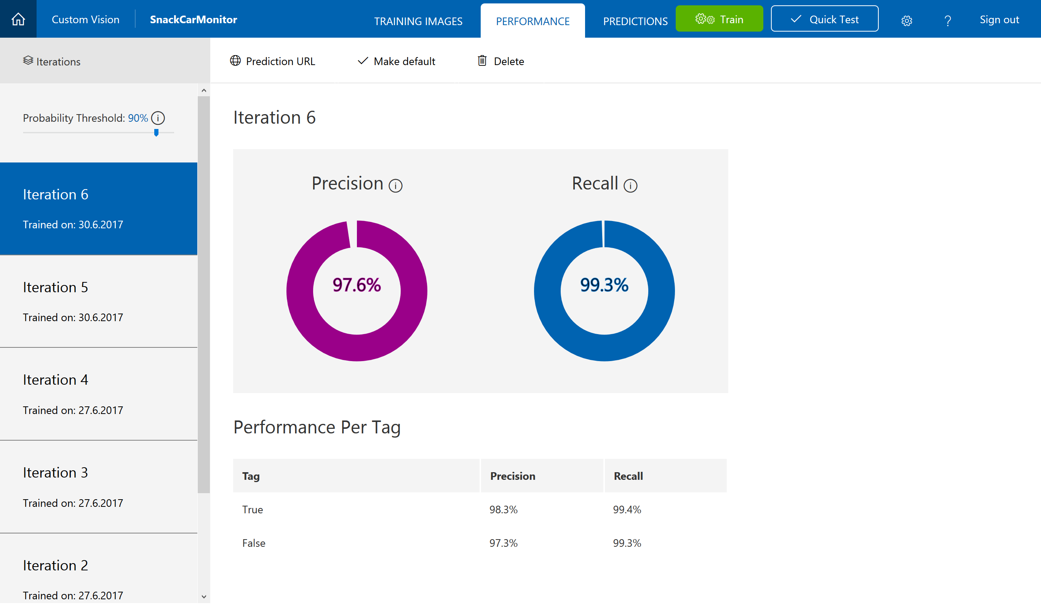
Custom Vision API
Project with sample data
Start with at least 30 images
Train the models
Use live data to learn in iterations
Be prepared to understand prediction results
Getting above 95% with ~450 images now

Slide 29
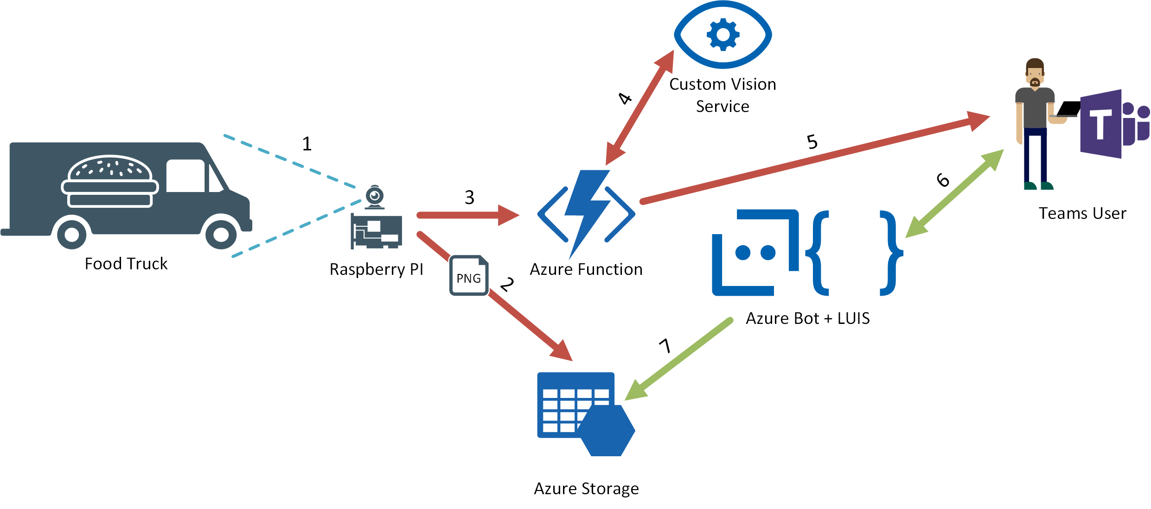
1. Raspberry PI camera takes photo of food truck, after it has arrived
2. Paspberry PI uploads the taken image into an Azure Blob Storage
3. Raspberry PI triggers an Azure Function after the image has been uploaded successfully
4. Azure Function calls the Custom Vision API in order to check wether the food truck is present or not
5. If Custom Vision API responds with a high probability that the truck has arrived, the Azure Function sends a notification to Teams
6. Users can ask the Lunchbell Bot in Teams wether the food truck has arrived or not or if it is still present
7. Azure Bot Service checks the entries in an Azure Table Storage where the arrival and departure time is stored

Slide 30
Bots & Cognitive Services
Notes:
SBI

Slide 31
1990s: Internet
Search
User “visits” websites
The future: Conversations
Natural language between people and technology
Conversational canvas
Bots and agents
The evolution of computers and IT
1980s: PC
Desktop
2000s: Mobile
Social
User download apps from App Stores

Slide 32
Bots 101
“a computer program designed to have a conversation with a human being, especially over the internet” *
* https://dictionary.cambridge.org/dictionary/english/chatbot

Slide 33
Bots 101
It’s one thing: it’s an app that performs an automated task
It solves the user’s needs in the quickest/easiest way compared to any other option... like an app, or a website
What makes a bot great:
It is not how much AI it has
It is not how much natural language it offers
It is not whether it uses voice or not

Slide 34




Bots 101
Platform
Platform services
HTTP
AI
{ Your Code }
Intelligent tools
REST Endpoint
SDK
Bot builder SDK
REST endpoint
Direct Line Protocol
Conversational and business logic
Canvas aware
Context sensitive

Slide 35
Microsoft Bot Framework

Slide 36
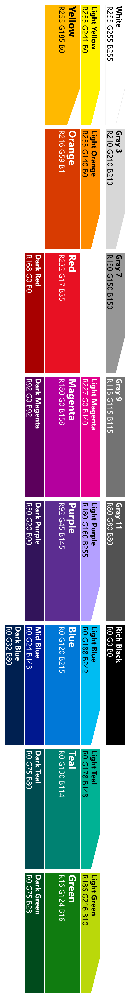
Modelling your conversation
Roll your own
state management etc.
Multi layered conversations
Bespoke
Dialogs
Data capture,
“Web forms” scenarios
Flexibility
FormFlow
FAQs,
command & control
QnA
Effort to implement

Slide 37

Conversational mechanisms
Text, with optional media attachments
Traditional chat, can contain media attachments (e.g., image, video, audio, file)
Input prompts
Suggested actions: Buttons, numbered items in a list, etc.
Rich cards, rendered as a list or carousel
Images, buttons, audio, animations, video, user sign-in, etc.
Hero | Audio | Animation | Thumbnail | Receipt | Sign In | Video | Adaptive | Purchase
Speech
Text-based chat using Speech Recognition & Synthesis (TTS)

Slide 38
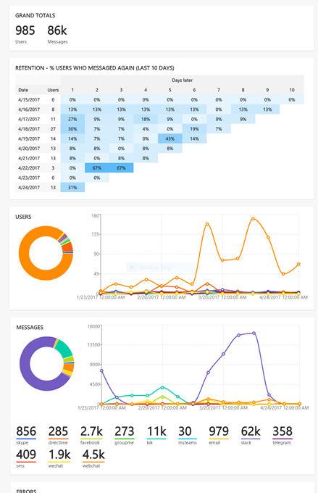
Continuous Improvement
Instrumentation provided by App Insights; added by default in Bot Service
Extend instrumentation through AI SDK
If you are not building bots that will actually be used, then you are not building bots

Slide 39
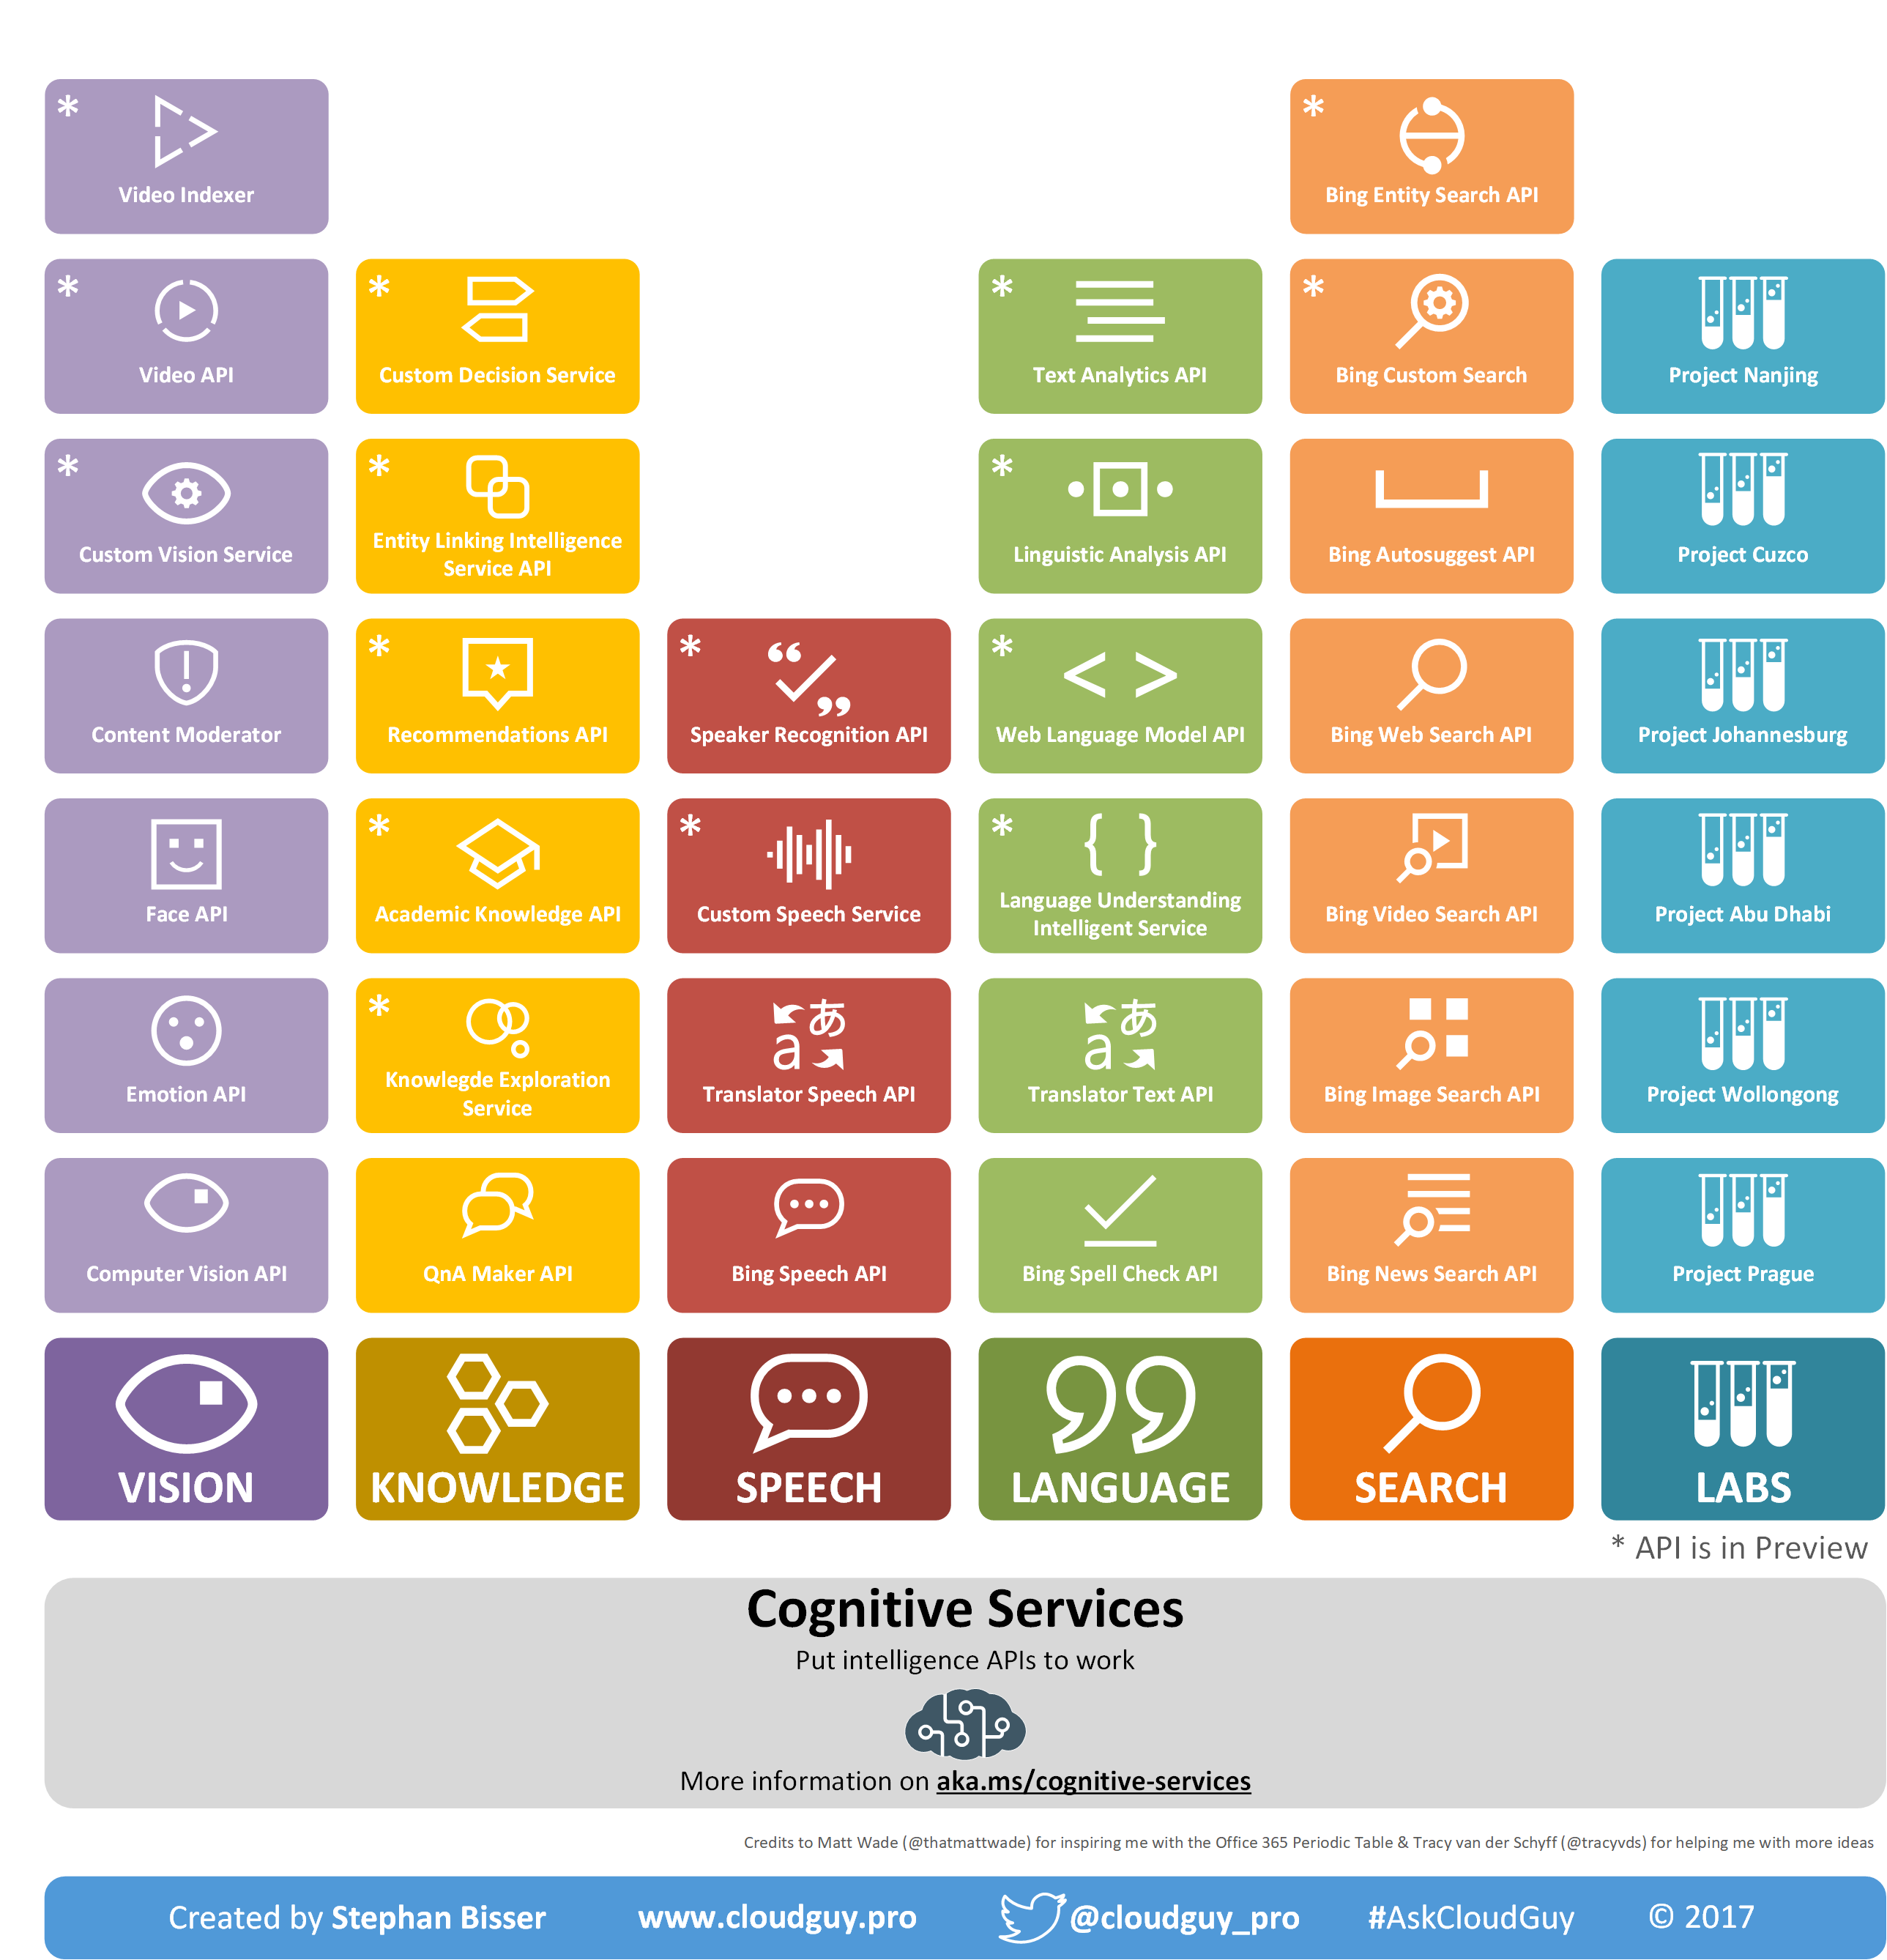
Microsoft Cognitive Services
Notes:
SBI

Slide 40
Custom Vision Service
Upload
Start with as little as 30 – 50 images per tag
Build a custom image classifier in 10 minutes or less
Diversity of images is key: angles, lighting, backgrounds
Not for object detection and is robust to subtle differences
Handles tuning model for edge cases (like misses)
Train
Build model on one of five featurizers
Predict
Deploy REST endpoint; identify 1+ tags
Iterate
New images are retained for tagging

Slide 41
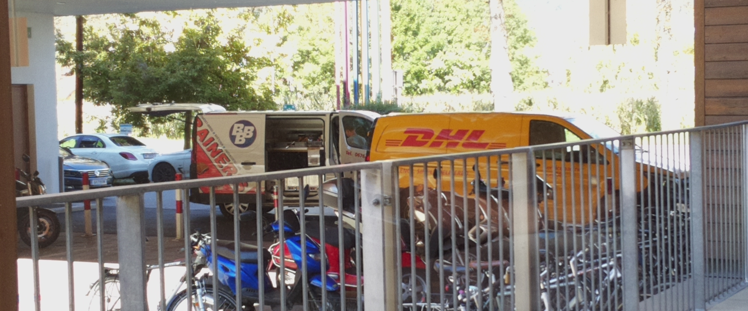
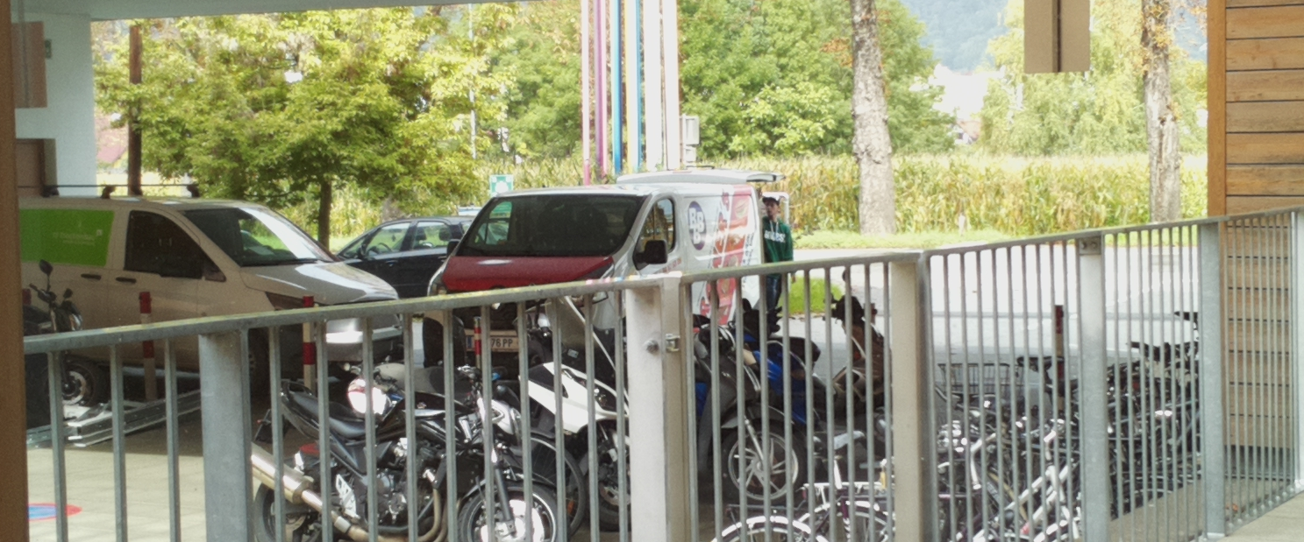
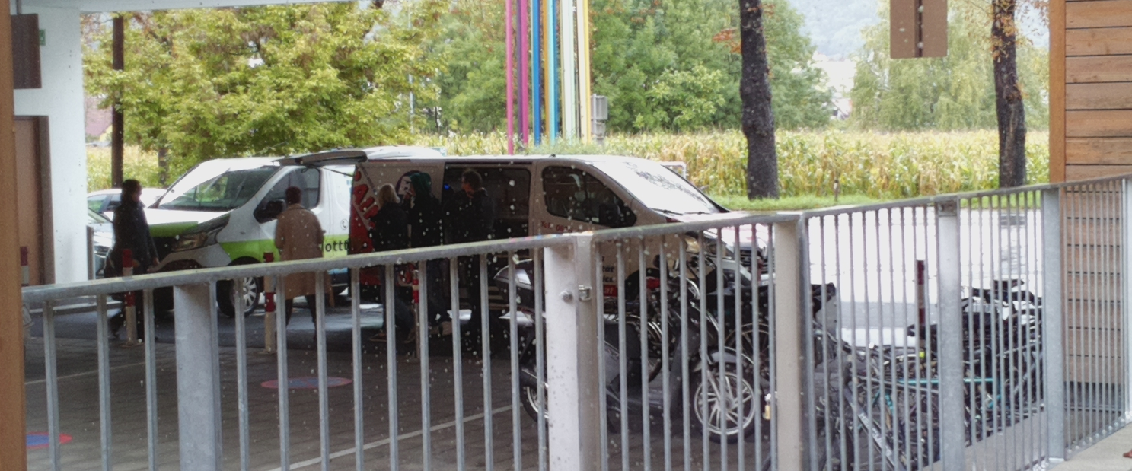
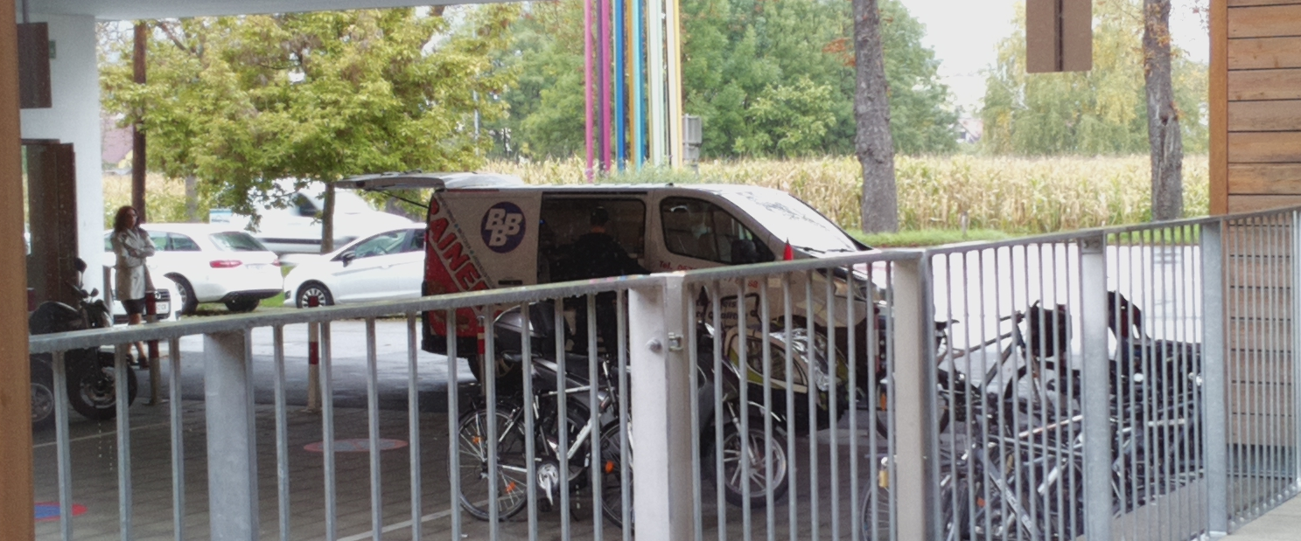
Custom Vision Service
99,9 % True
100 % True
Normal State
98,53 % True
Notes:
SBI

Slide 42
Building image classification using the Microsoft AI platform
BRK3334
Alok Kirpal, Anusua Trivedi, Patrick Buehler
Cloud AI, Microsoft

Slide 43

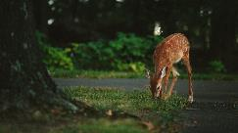
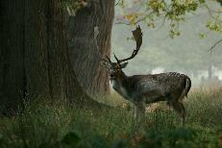
Computer Vision Tasks
Image Classification
Is there a deer in the image?
Object detection
Where in the image is the deer?
Image segmentation
Where exactly is the deer? What pixels?
Image Similarity
Which images are similar to the query image?
Yes
Query image
Similar image

Slide 44
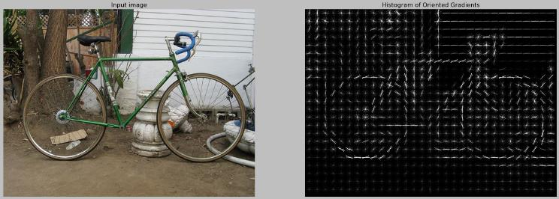
Before Deep Learning
Researchers took a traditional machine learning approach
Manual creation of a variety of different visual feature extractors
Followed by traditional ML classifiers
Example: HoG Detectors
Histogram of oriented gradients (HoG) features
Sliding window detector
SVM Classifier
Very fast OpenCV implementation (<100ms)

Slide 45
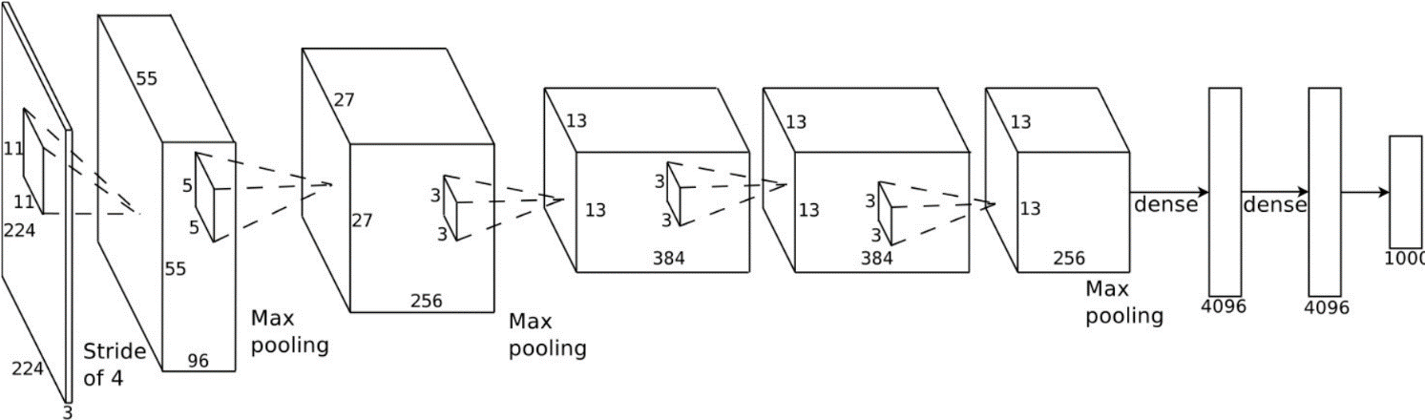
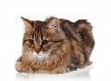





Deep Neural Network for Computer Vision
Fully Connected Layers
Convolutional Layers
cat? YES
dog? NO
car? NO
Low-Level Features (lines, edges, color fields, etc.)
High-Level Features (corners, contours, simple shapes)
Object Parts (wheels, faces, windows, etc.)
Complex Objects & Scenes (people, animals, cars, beach scene, etc.)
Image

Slide 46
Language Understanding
„Has the food truck arrived?“
„Has the food truck arrived?“
[ $LunchBell.Object ] [ $LunchBell.Operation ]
Intent = CheckArrivalState
www.luis.ai

Slide 47
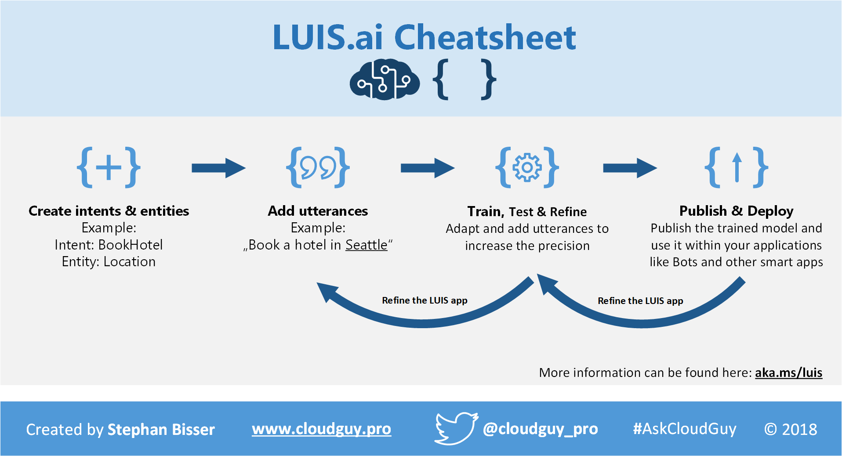

Slide 48
Where does the lunchbell ring?

Slide 49
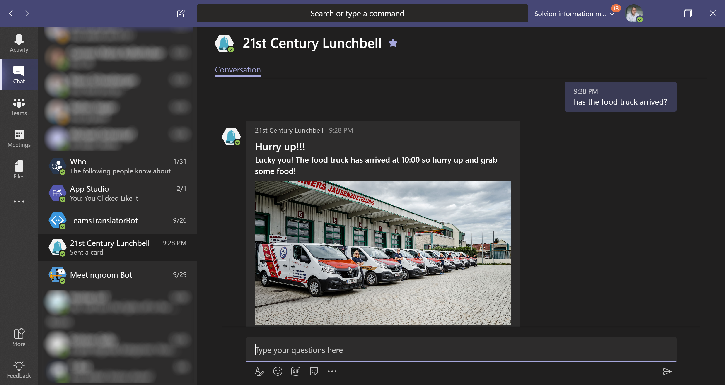
Microsoft Teams

Slide 50
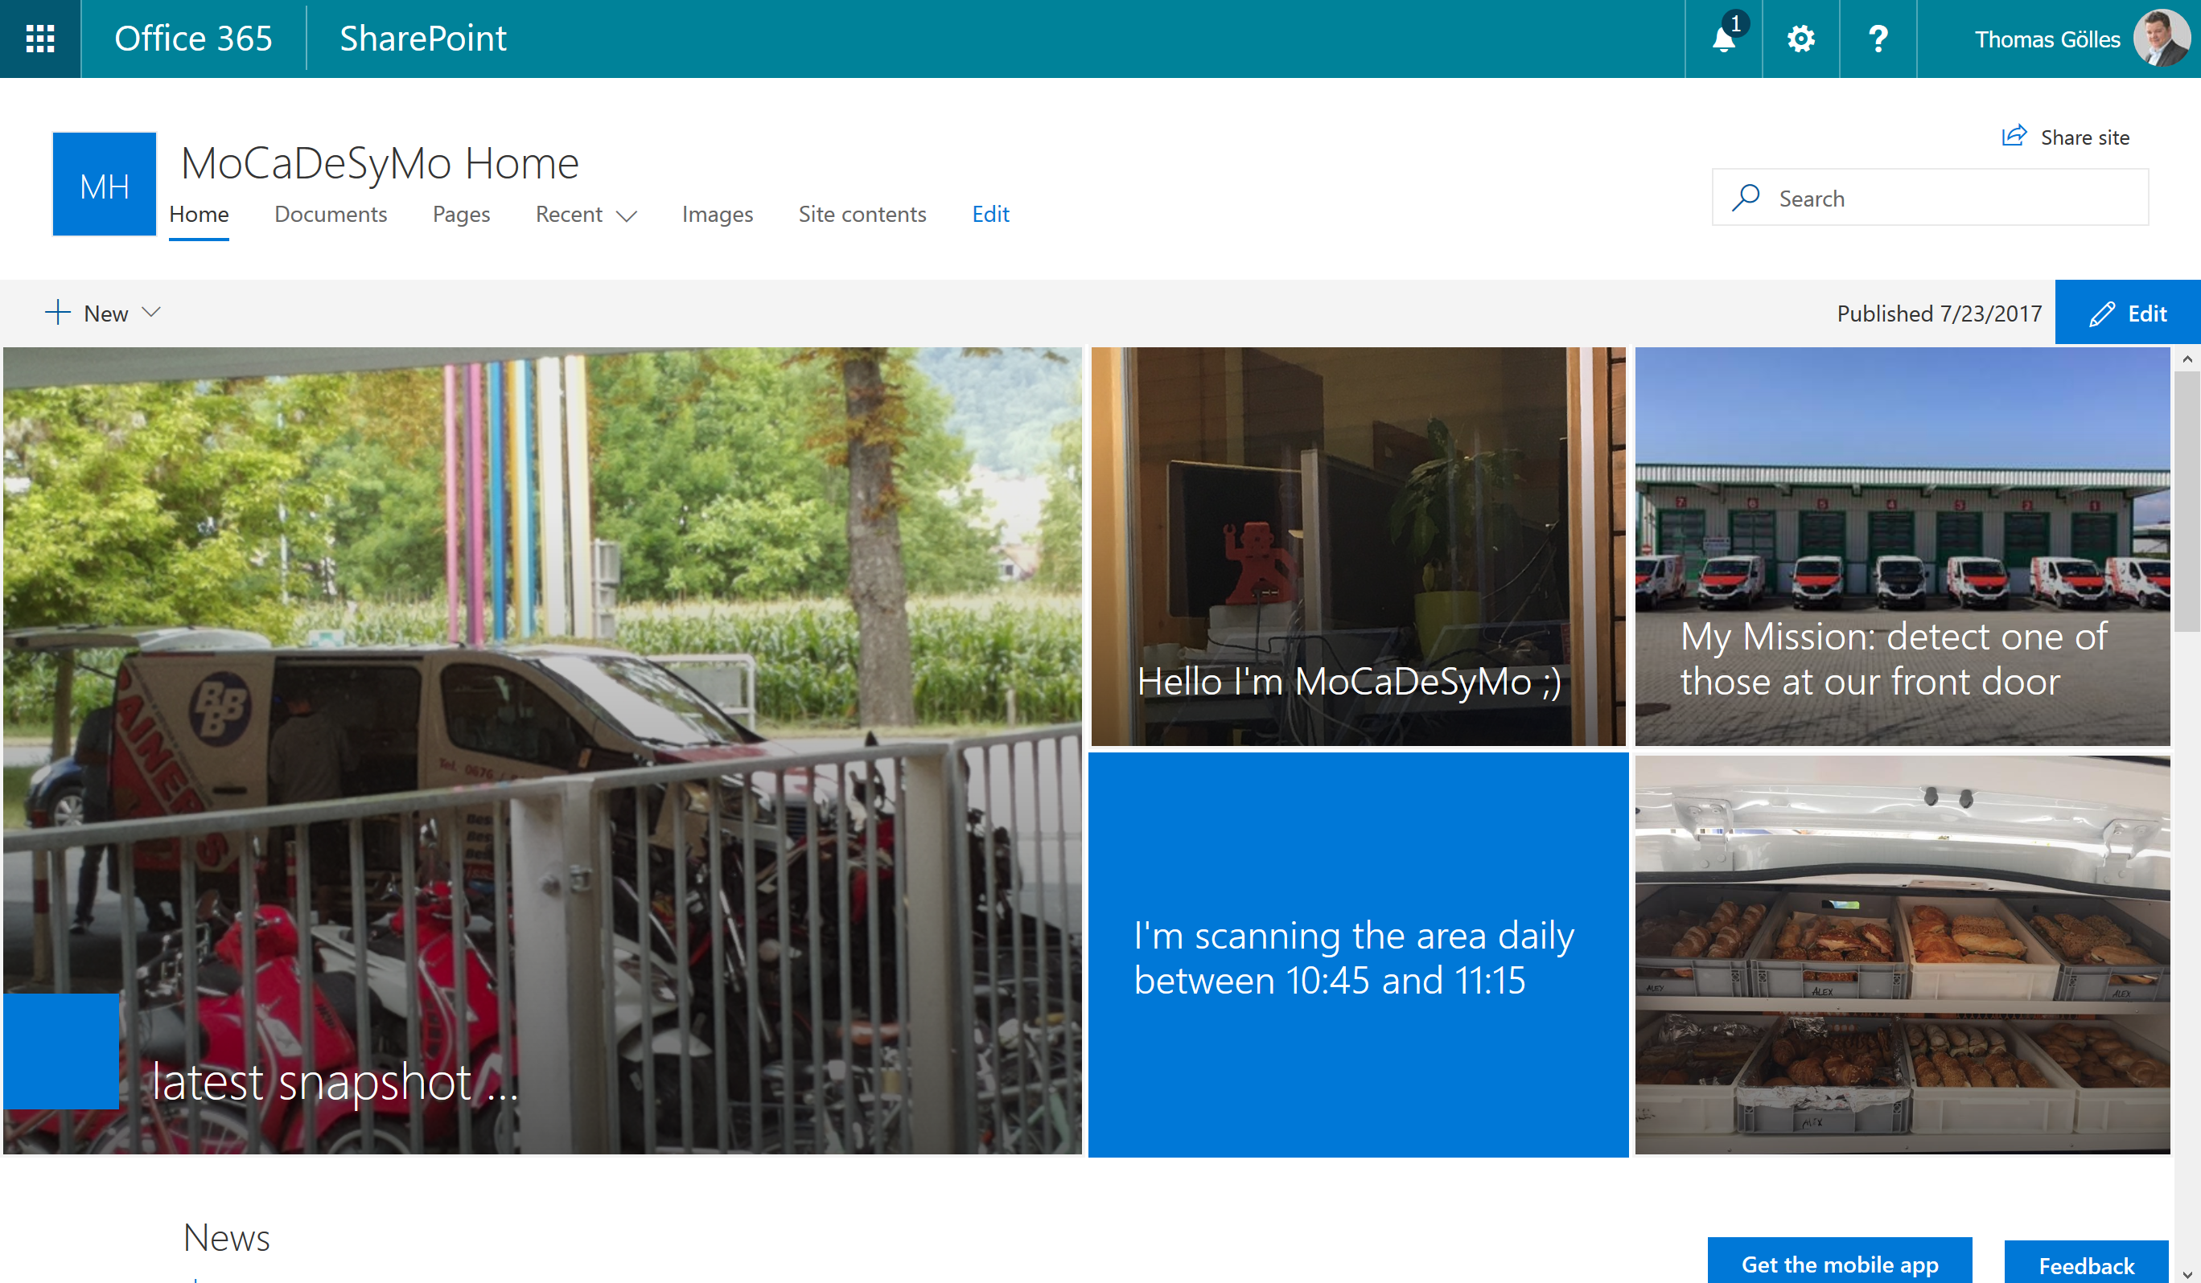
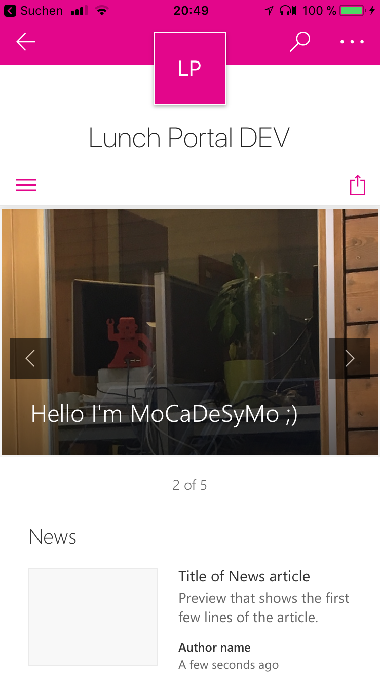
SharePoint Online

Slide 51
DEMO

Slide 52
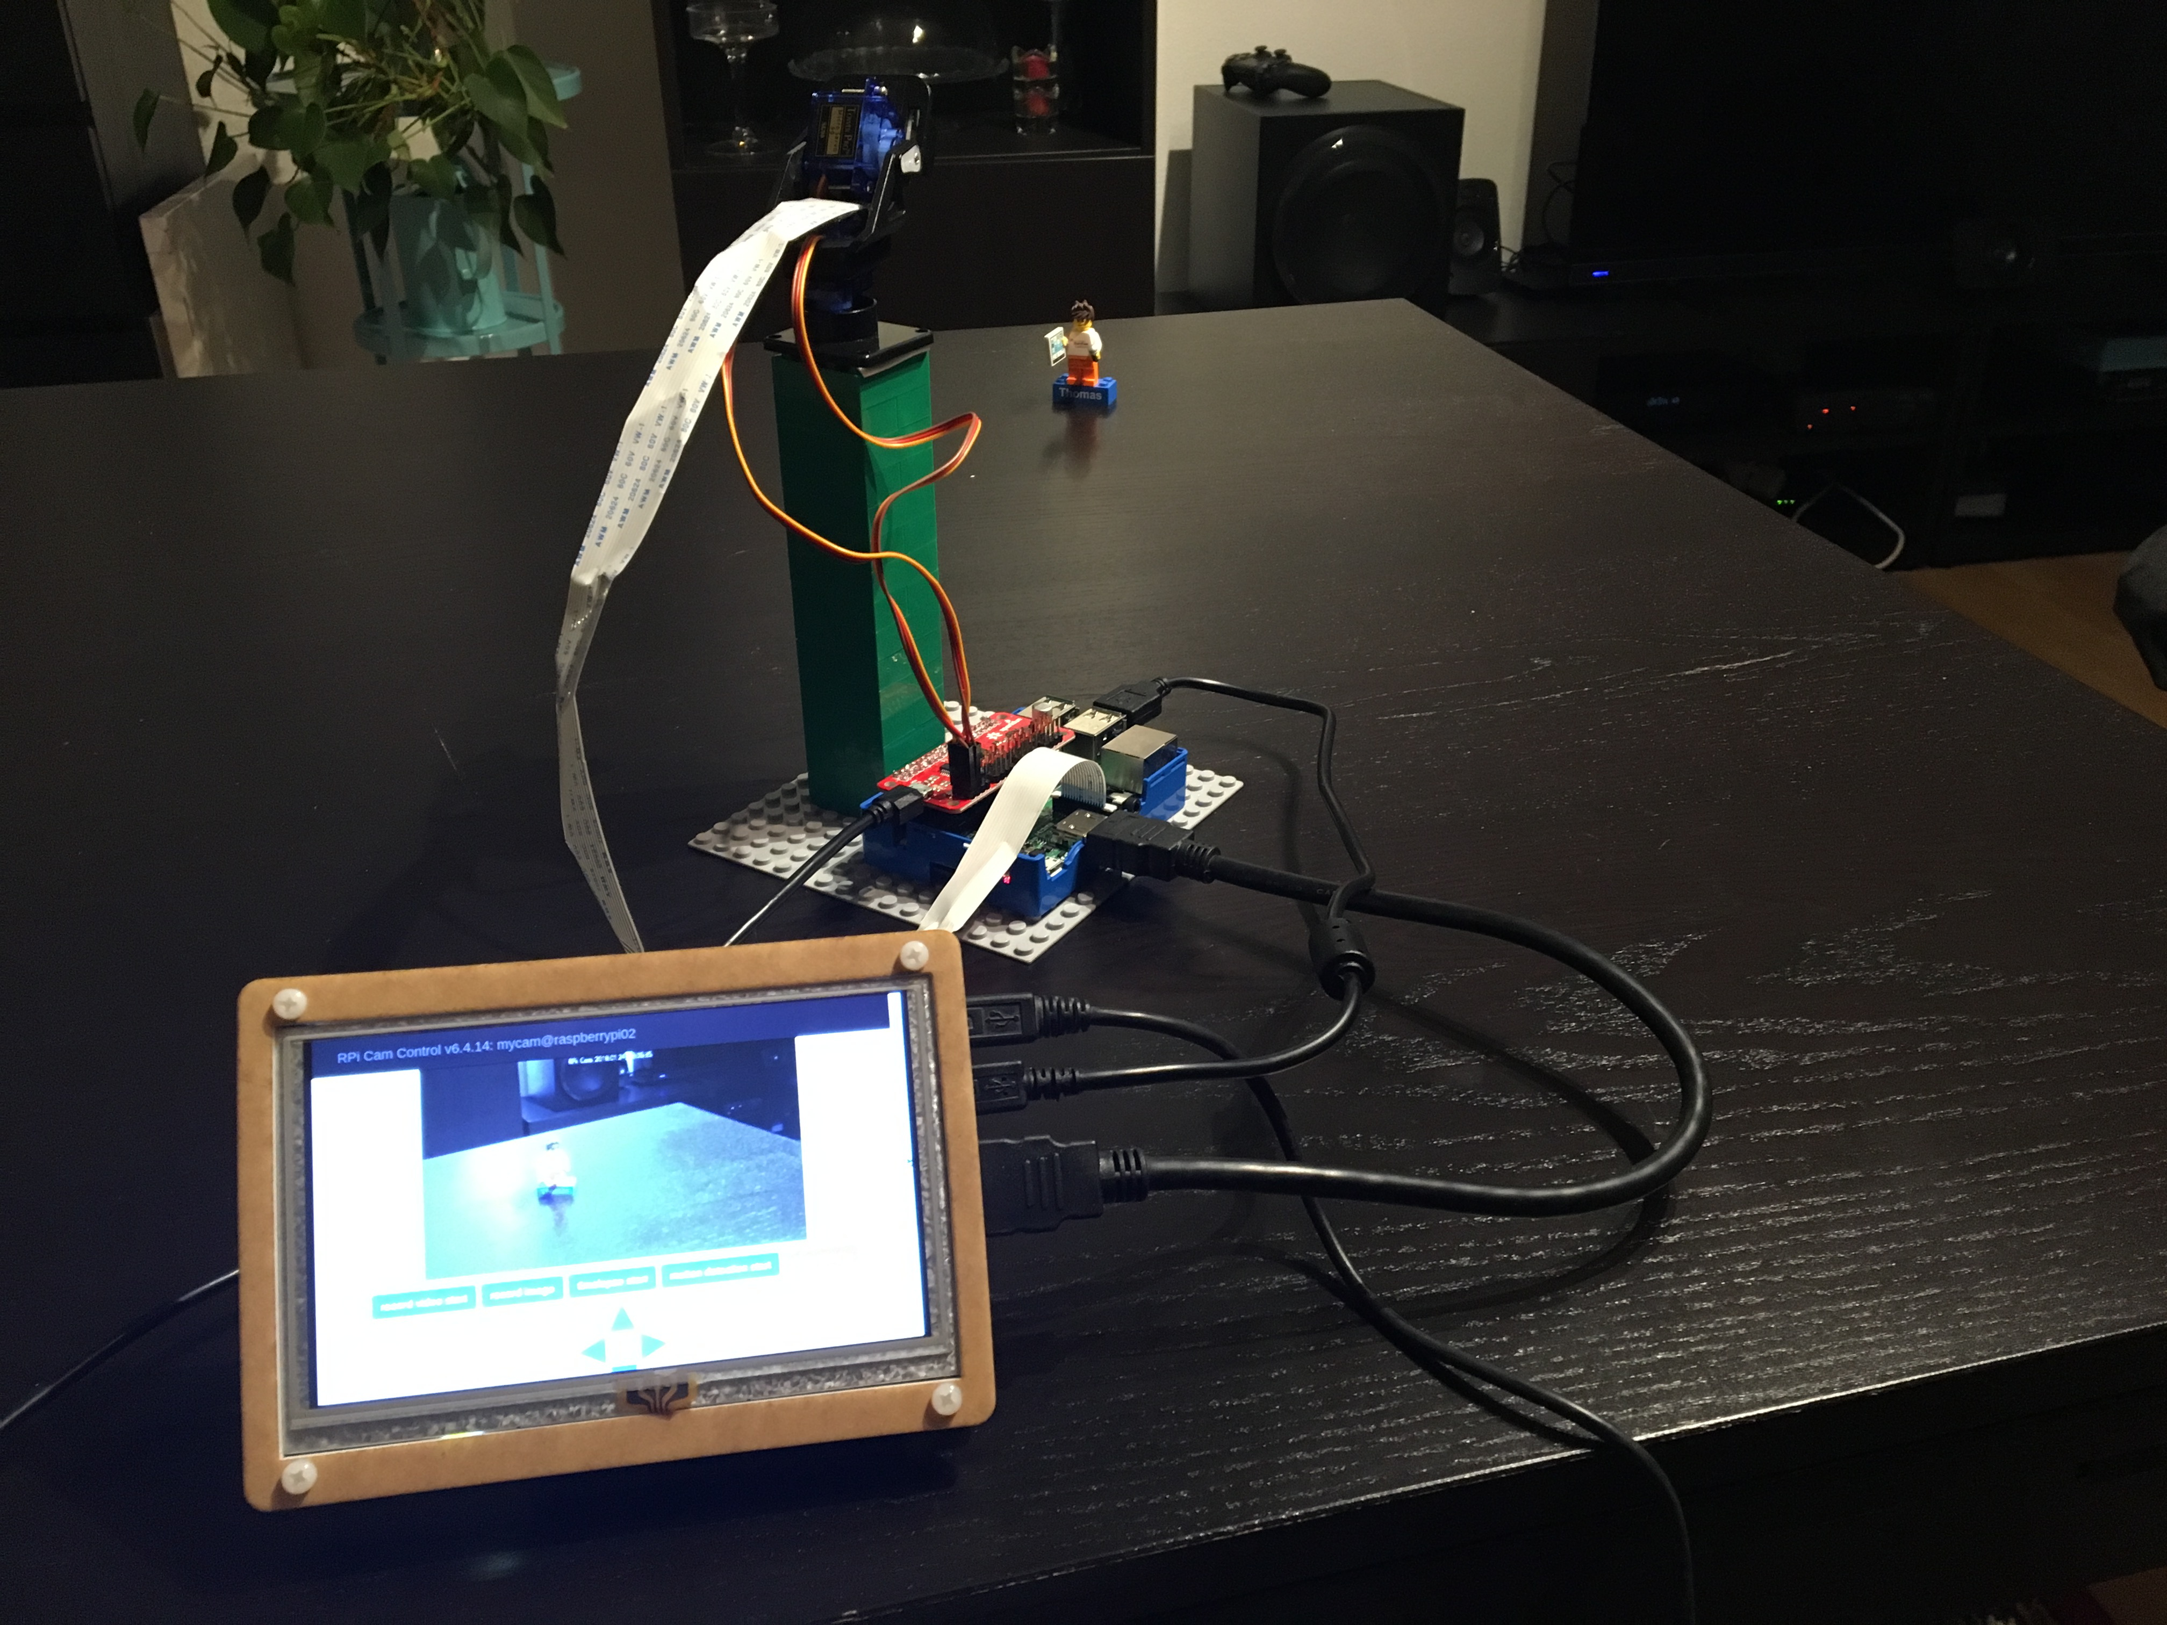
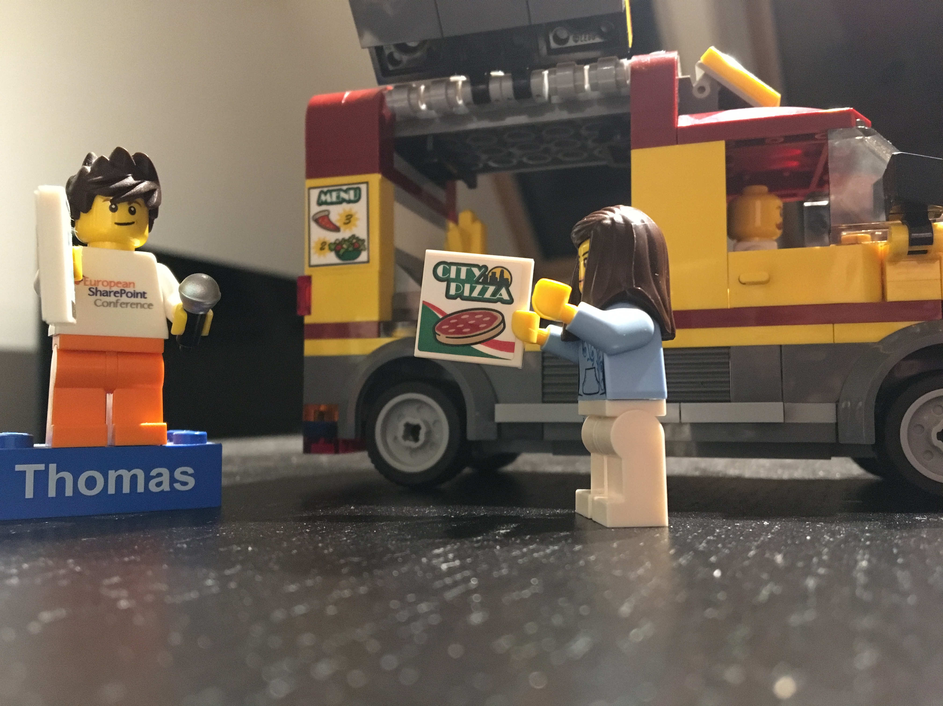

Slide 53
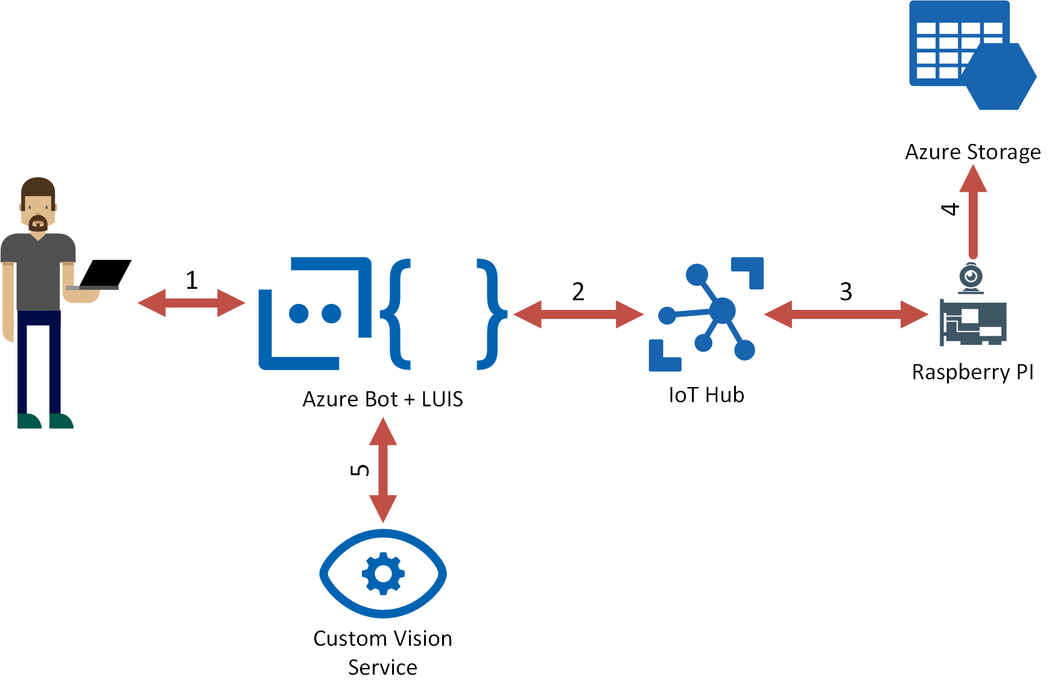
Demo Case

Slide 54
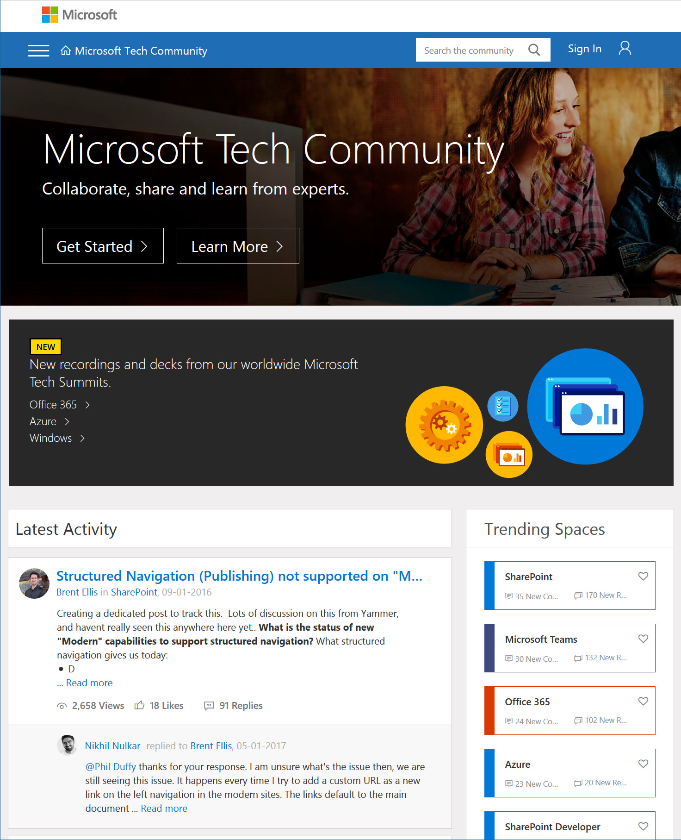
Microsoft Tech Community
techcommunity.microsoft.com
One Microsoft community for IT Pros and tech enthusiasts to learn from experts on Microsoft products
Trusted resource for news, best practices and answers from Microsoft product teams and MVPs
Join today! It’s free – sign in with your Microsoft Account.

Slide 55
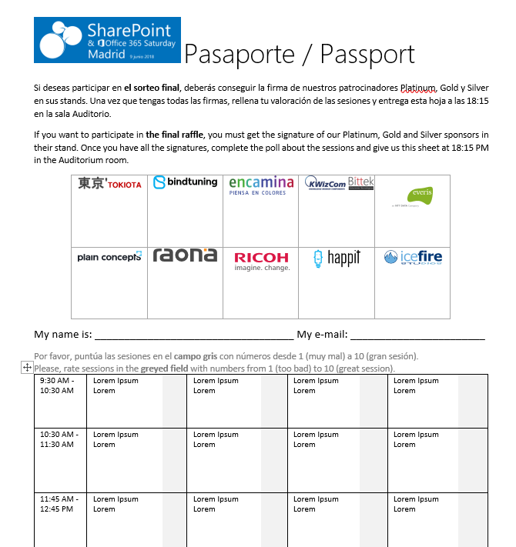




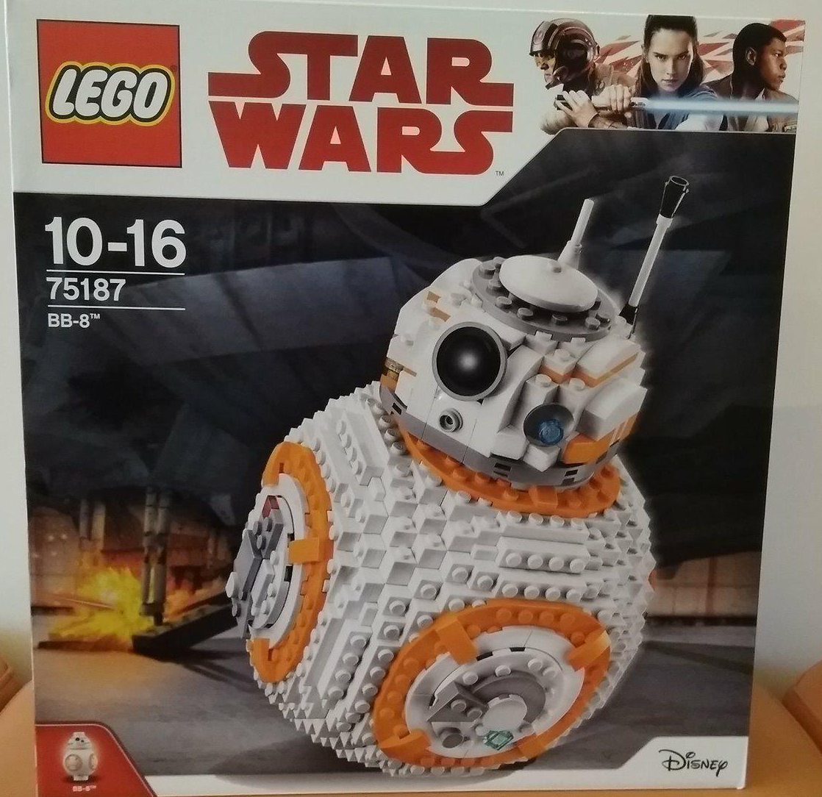


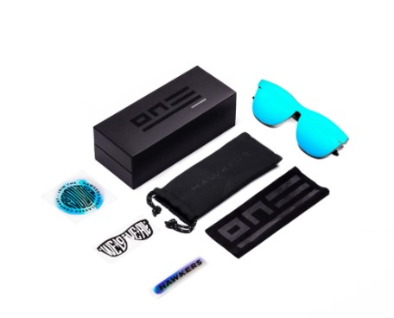


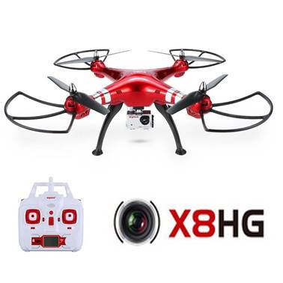




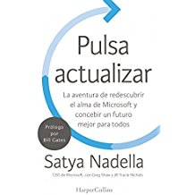
Raffle
Please, fill your SP & Office 365 Saturday Madrid passport if you want to participate.
You can win one of these gifts:
Please, fill your SP & Office 365 Saturday Madrid passport if you want to participate.
You can win one of these gifts:
Odor
Odor@winterfell.com
10
9
2x
2x
8

Slide 56
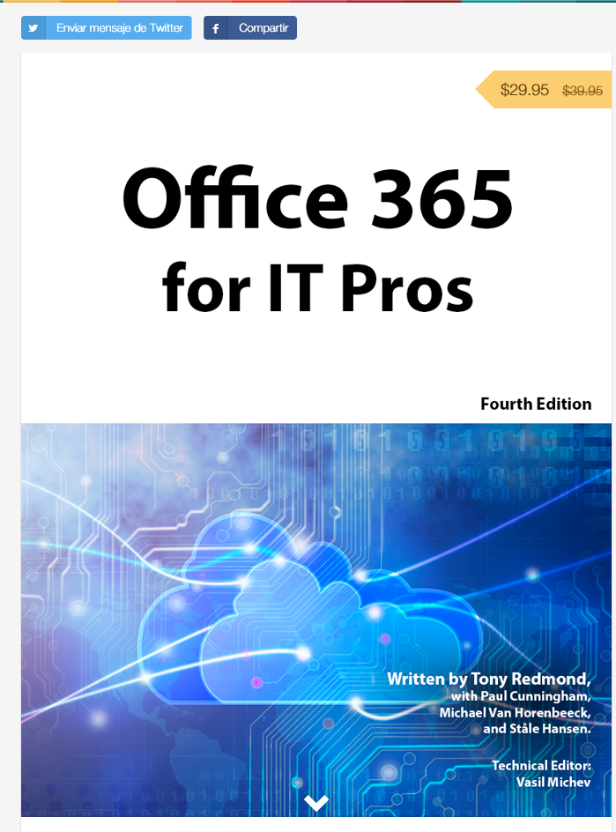
Office 365 for IT Pros
Get a discount of $10 buying the book here: https://gumroad.com/l/O365IT/spsspain

Slide 57
Notes:
This slide is mandatory. Please do not remove and try to use it during Q&A at the end of your session. Thank you!

Slide 58
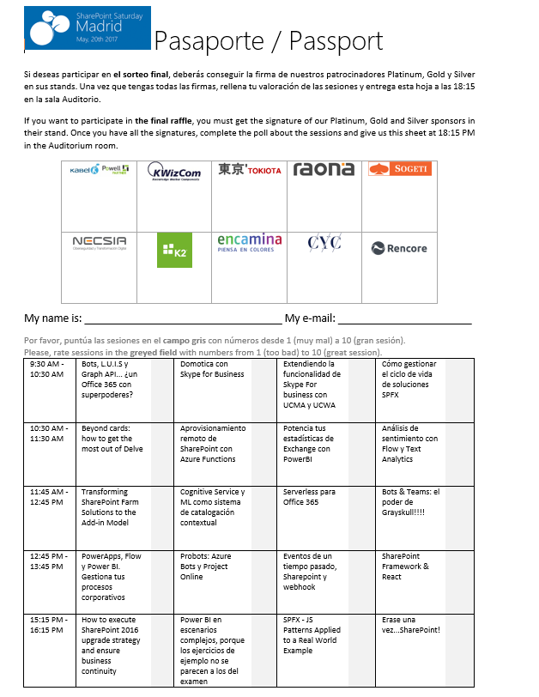
Raffle
Please, fill your SP & Office 365 Saturday Madrid passport if you want to participate.
You can win one of these gifts:
Odor
Odor@winterfell.com
10
9
8

